Slide 1
PhD Final Model
2/14/2018
Ben Cohen

Slide 2
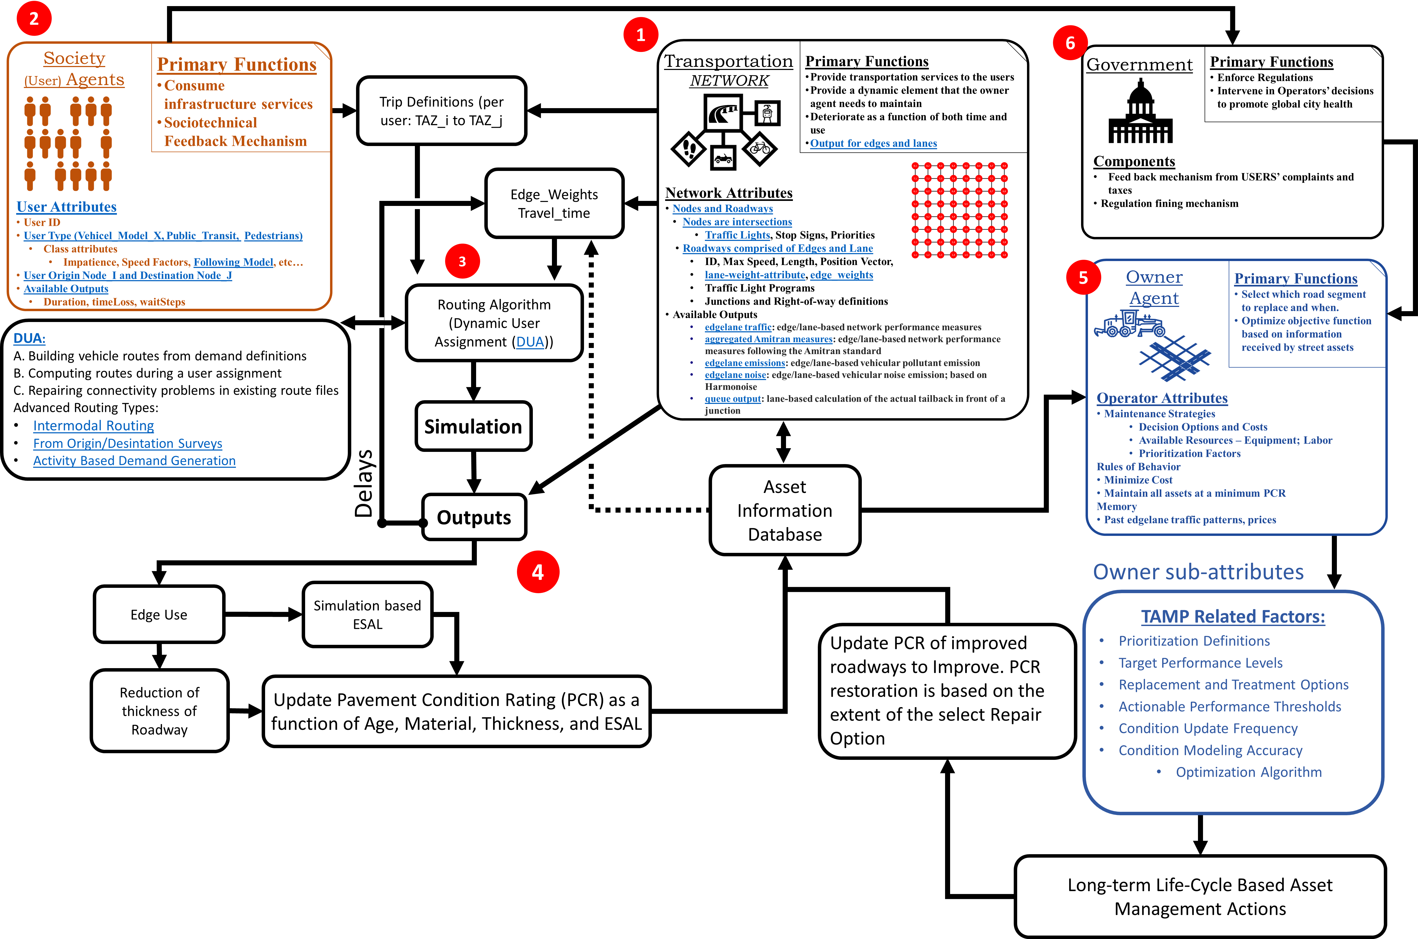
Flow Chart of ABM Simulation of Transportation Asset Management

Slide 3
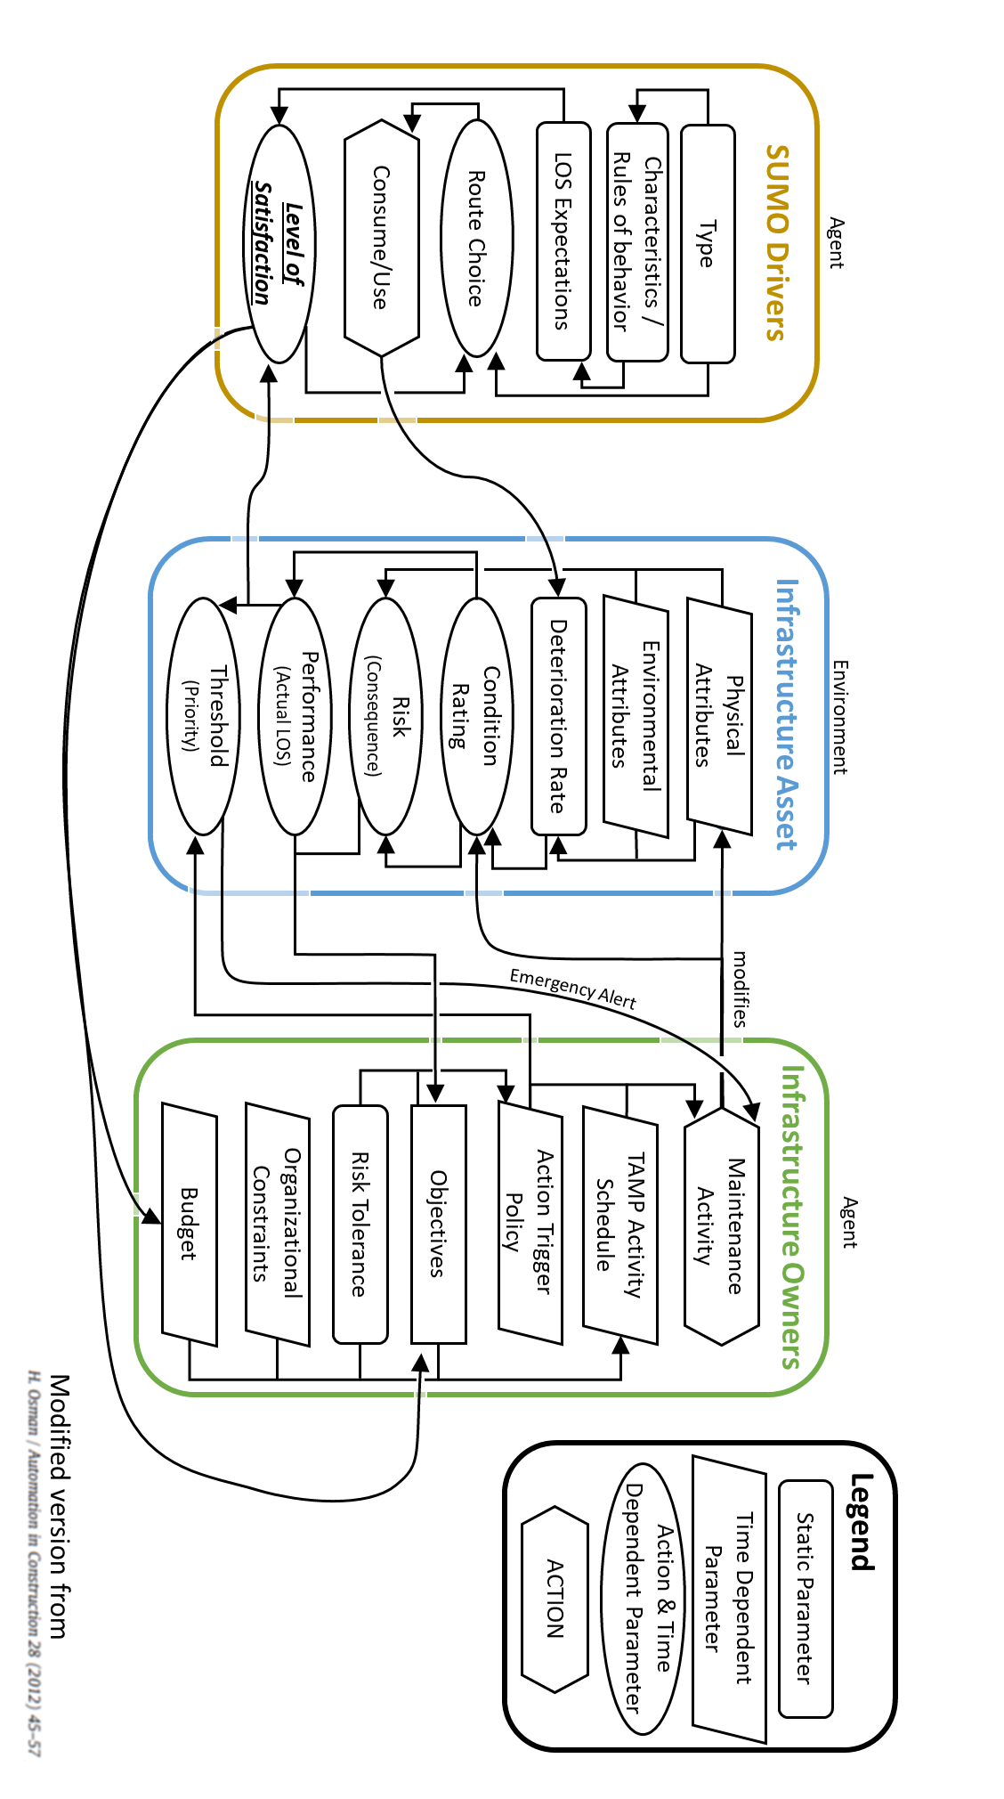
PhD Research - Agents and Roadway (environment) Dynamics

Slide 4
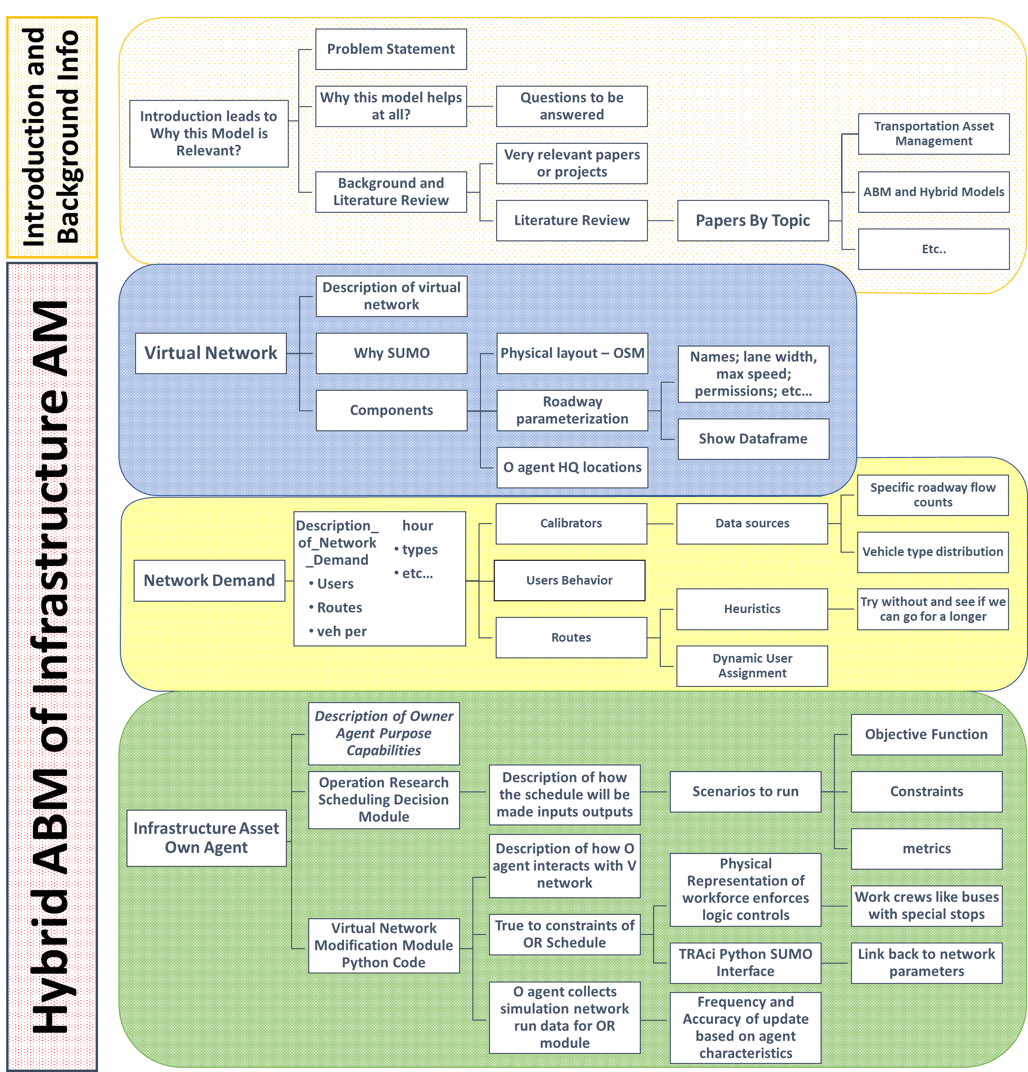
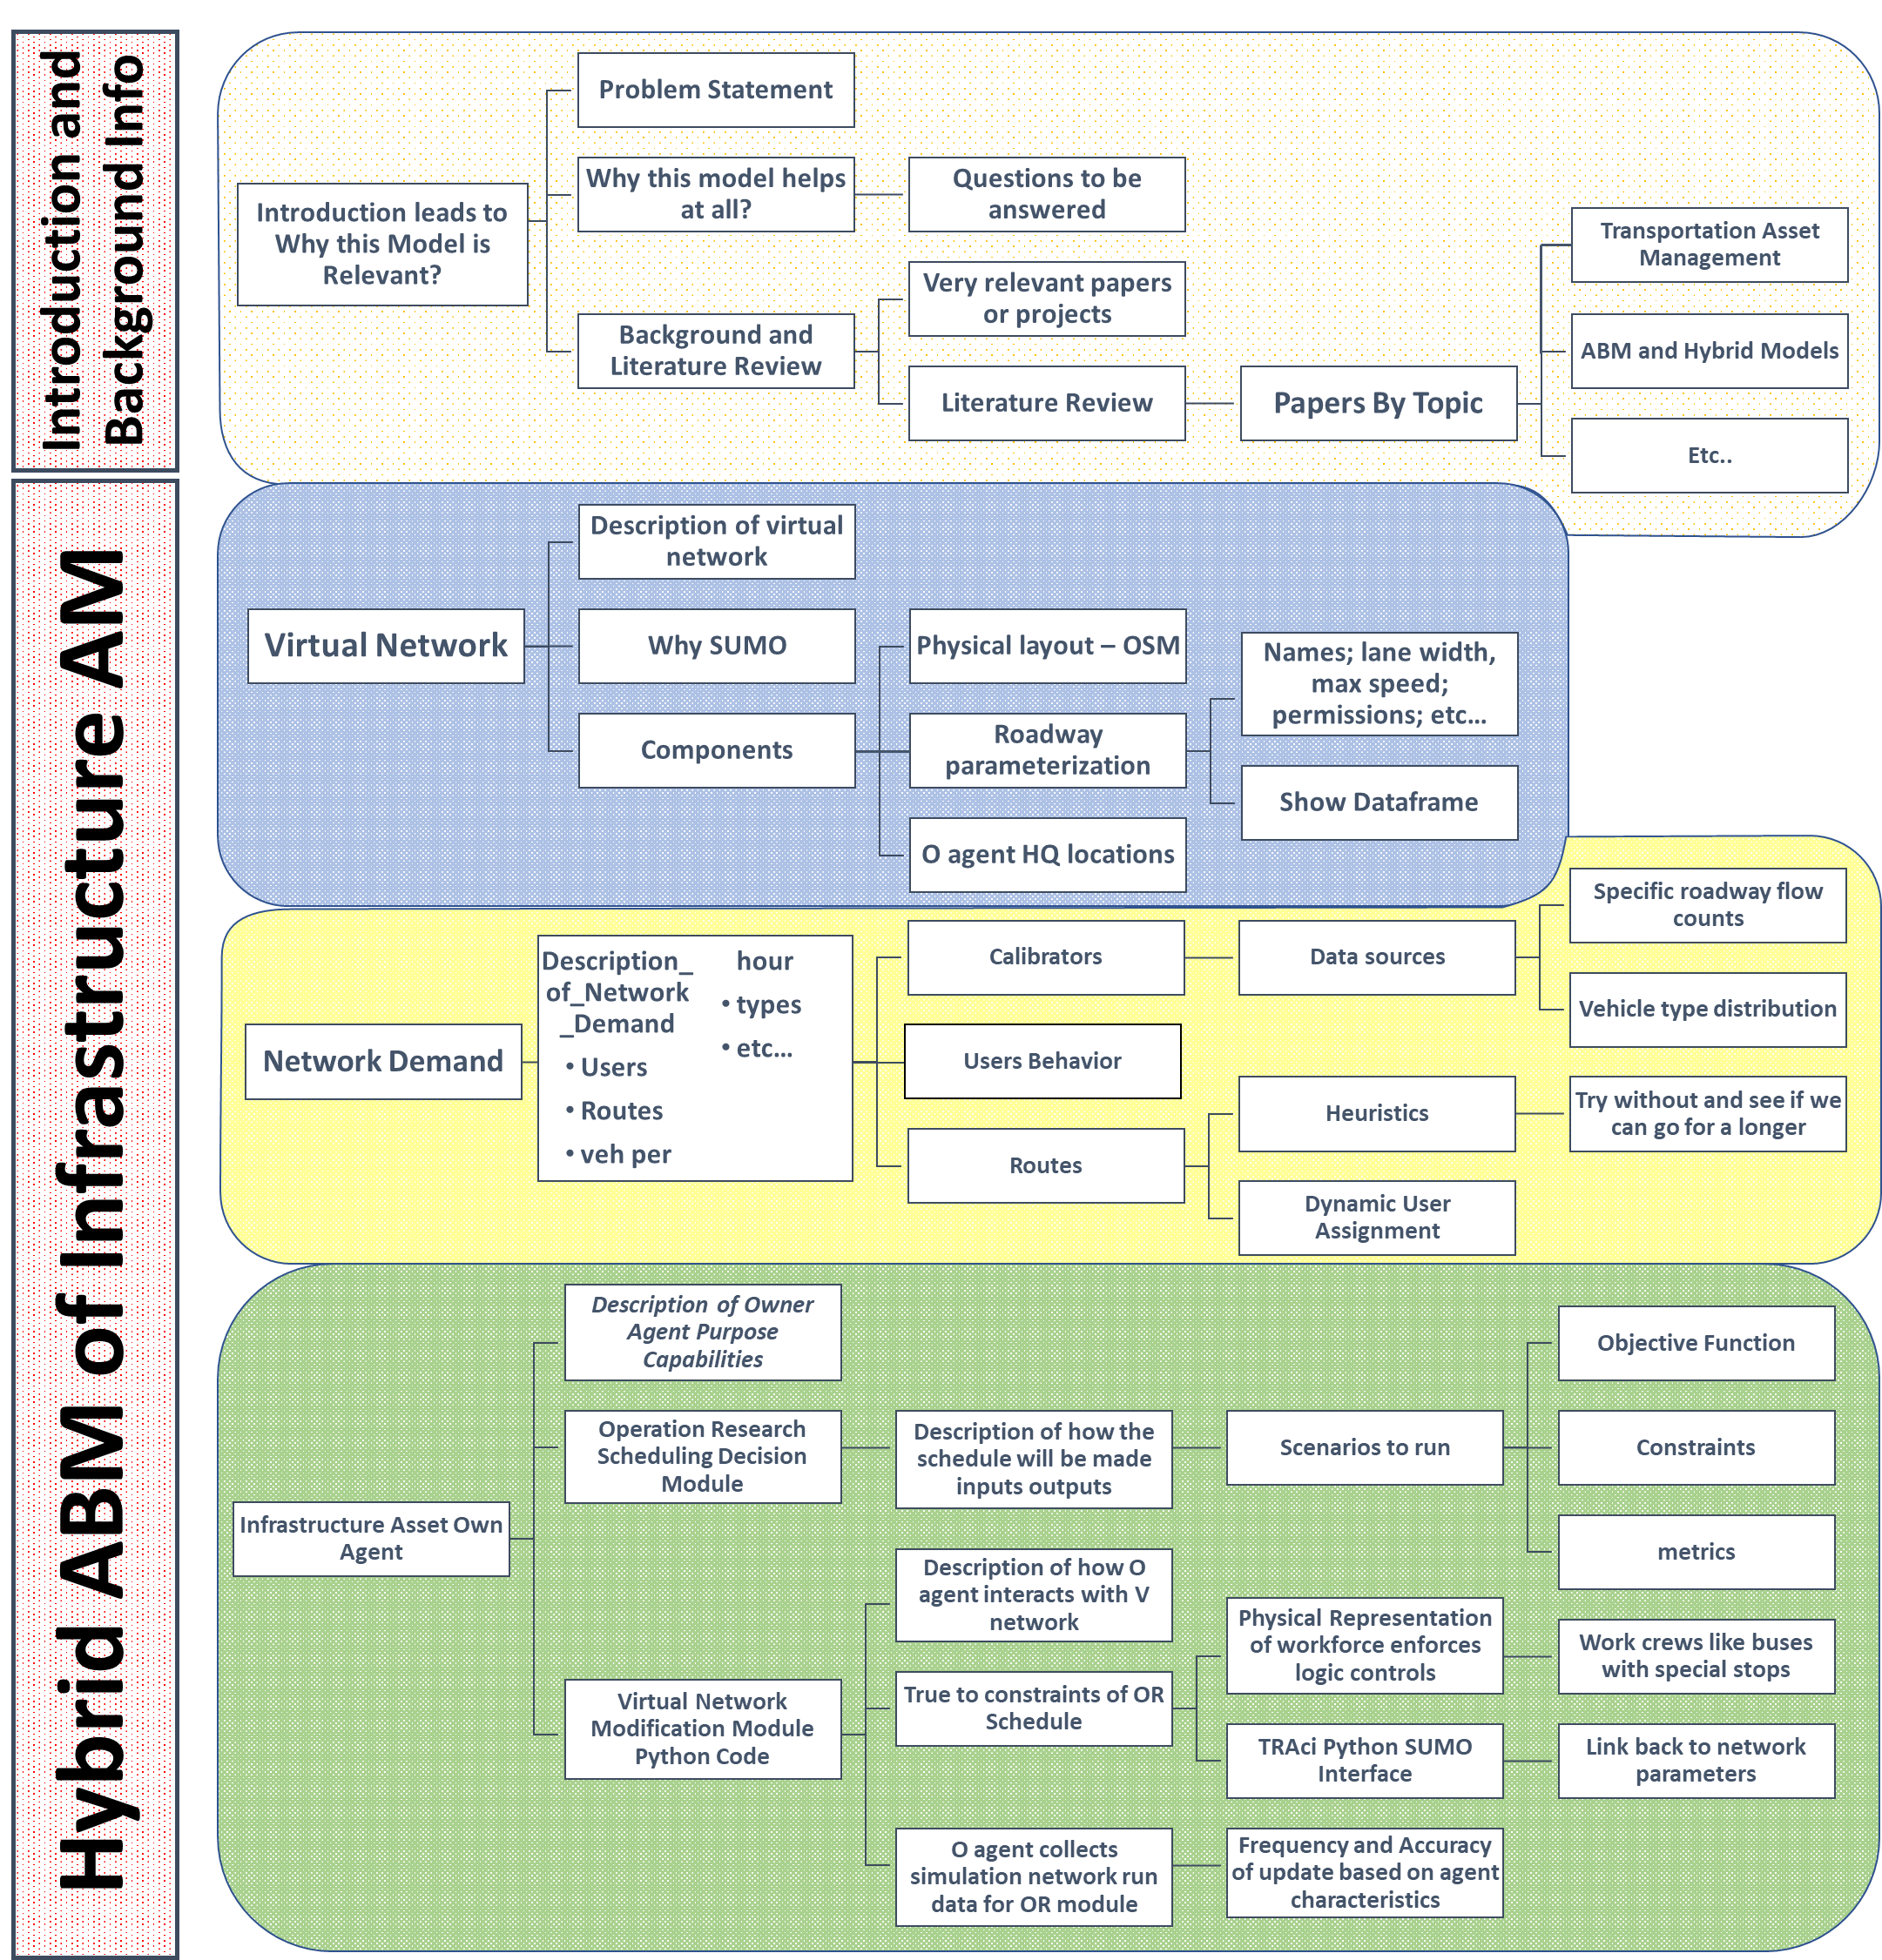
Tree Structure

Slide 5
INTRO
Problem statement
Can we model the current state of TAM
at the Local Municipalities (City Ownership)
[via a Hybrid ABM]
to Examine Potential Impacts to Livability, Sustainability, and Resilience
Due to different Agency Type Scenarios:
(1) Worst First vs.
(2) Single Asset Optimization vs.
(3) Network Optimization vs.
(4) Multi-Objective Sociotechnical Optimization
…

Slide 6
Surface Transportation Funding Bills - MAP-21 and the FAST Acts
Transportation Planning [1201 & 1202]
MAP-21 made a number of reforms to the metropolitan and statewide transportation planning processes, including incorporating performance goals, measures, and targets into the process of identifying needed transportation improvements and project selection. The FAST Act includes provisions to support and enhance these reforms. Public involvement remains a hallmark of the planning process.
National Highway Performance Program [1106]
The FAST Act provides an estimated average of $23.3 billion per year for the NHPP, which will support the condition and performance of the National Highway System (NHS)
Enable the construction of new facilities on the NHS
Ensure that investments of Federal-aid funds in highway construction are directed to support progress toward achieving performance targets established in a State’s asset management plan for the NHS.
The FAST Act also makes the following changes to NHPP eligibilities:
It allows States to use NHPP funds for reconstruction, resurfacing, restoration, rehabilitation, or preservation of a non-NHS bridge if the bridge is on a Federal-aid highway.
At a State’s request, the Secretary now may use a State’s NHPP apportionment to pay the subsidy and administrative costs for TIFIA credit assistance for an eligible project.
It provides specific NHPP eligibility for vehicle-to-infrastructure (V2I) communication equipment.

Slide 7
Recap – Current State of Affairs of in Transportation Asset Management
While the current transportation infrastructure asset management plans analyze assets as part of an inventory, they fall short in providing adequate overall network level performance.
The limited available transportation funds are used to address critical short term concerns, while long-term cost savings and performance enhancement measures are push aside.
The “worst first” prioritization methodology can lead to unintended changes and greater future expenditures:
The transportation network has many links (interdependencies) with other engineered and “natural” systems. This creates a high level of complexity within the network that is difficult to predict its future state.
Natural and man-made events, such as flooding or new development, can create additional stresses to the system. There is a demand that is not currently being met, at the local level, to be able to simulate these events and develop strategies to mitigate their effects.
States are likely to begin to put pressure on local municipalities to comply with the data collection and reporting standards required under MAP-21 and the FAST act. It is important to explore how these new requirements can be beneficial to the old way of business for the cash strapped local DOTs.
National Highway Performance Program [1106]
The FAST Act provides an estimated average of $23.3 billion per year for the NHPP, which will support the condition and performance of the National Highway System (NHS)
Enable the construction of new facilities on the NHS
Ensure that investments of Federal-aid funds in highway construction are directed to support progress toward achieving performance targets established in a State’s asset management plan for the NHS.
The FAST Act also makes the following changes to NHPP eligibilities:
It allows States to use NHPP funds for reconstruction, resurfacing, restoration, rehabilitation, or preservation of a non-NHS bridge if the bridge is on a Federal-aid highway.
At a State’s request, the Secretary now may use a State’s NHPP apportionment to pay the subsidy and administrative costs for TIFIA credit assistance for an eligible project.
It provides specific NHPP eligibility for vehicle-to-infrastructure (V2I) communication equipment.
Notes:
While the current transportation infrastructure asset management plans analyze assets as part of an inventory, they fall short in providing adequate overall network level performance.
The limited available transportation funds are used to address critical short term concerns, while long-term cost savings and performance enhancement measures are push aside.
We need a way to balance funding allocations between meeting the current needs, while addressing long-term network and asset performance.
Greater network performance can lead to an increase in user satisfaction, which can ultimately lead to a healthier, sustainable, and resilient city.
The “worst first” prioritization methodology can lead to unintended changes and greater future expenditures:
Changes in traffic flows → increasing the rate of damage to adjacent assets
Longer repair times on major corridors → increased user travel times
Optimizing single assets → sub-optimized network performance
The current software uses a Markov Chain process for predicting future asset needs. This method is not able to account for many factors that lead to deterioration of an asset.
The transportation network has many links (interdependencies) with other engineered and “natural” systems. This creates a high level of complexity within the network that is difficult to predict its future state.
Natural and man-made events, such as flooding or new development, can create additional stresses to the system. There is a demand that is not currently being met to be able to simulate these events and develop strategies to mitigate their effects.
States are likely to begin to put pressure on local municipalities to comply with the data collection and reporting standards required under MAP-21 and the FAST act. It is important to explore how these new requirements can be beneficial to the old way of business for the cash strapped local DOTs.
Transportation Infrastructure Finance and Innovation Act (TIFIA)

Slide 8
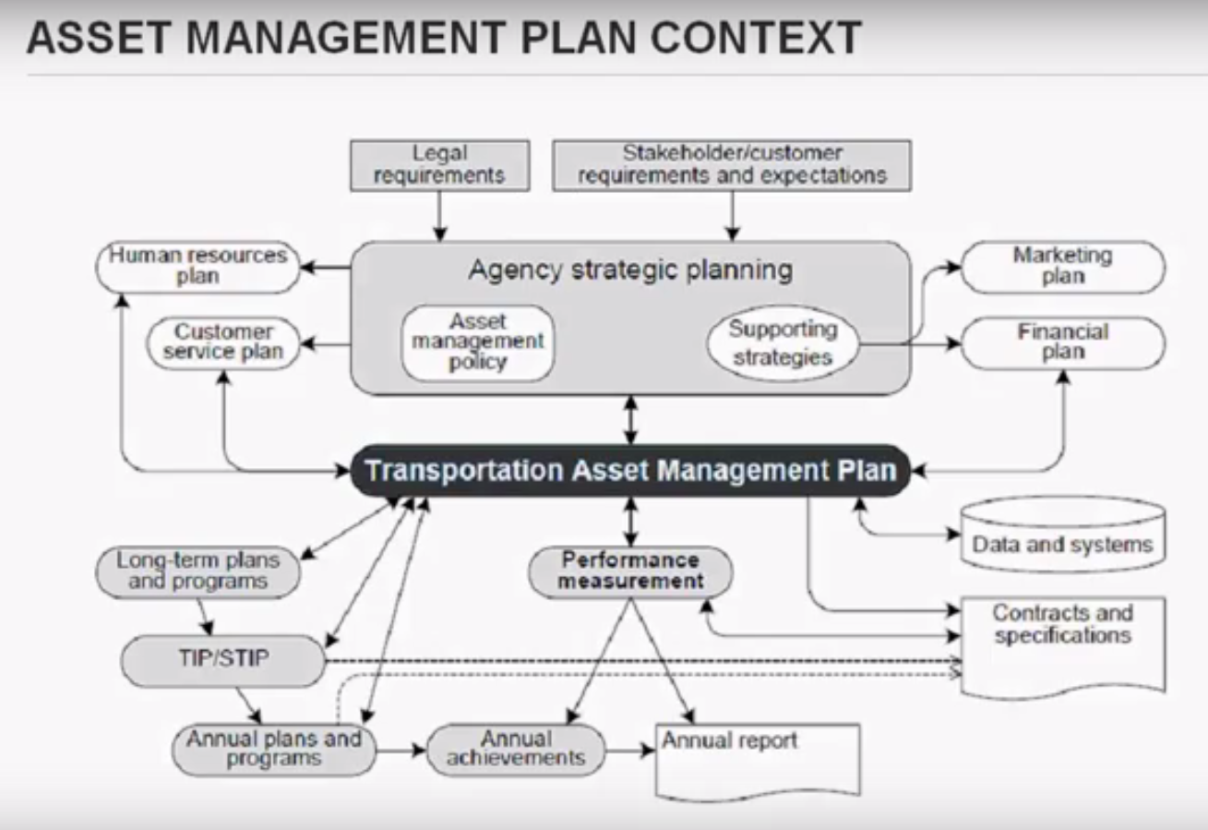
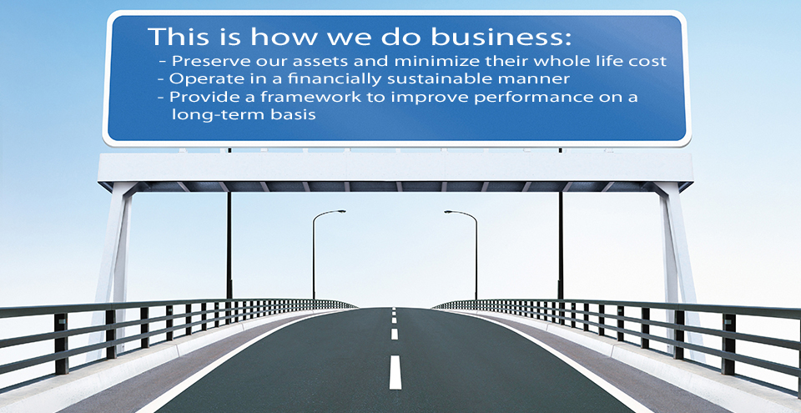
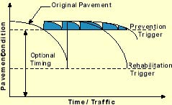

Asset Management – FHWA ^{Style}
“The goal of infrastructure asset management is to meet a required level of service, in the most cost effective manner, through the management of assets for present and future customers.” - NAMS
The systematic approach to the integrated management of the highway infrastructure to deliver agreed service levels at minimum whole-life value
Recognize that the revenue available for asset management is a significant constraint!

Slide 9
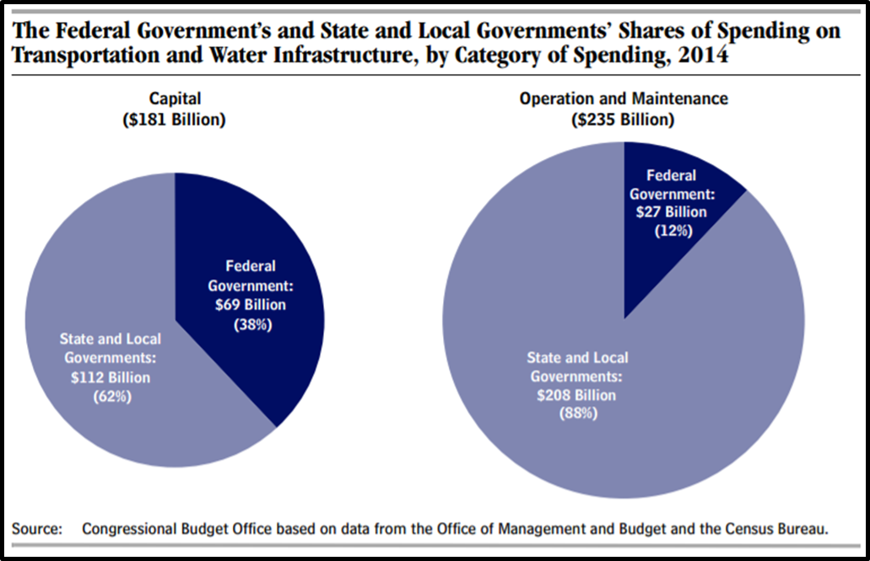
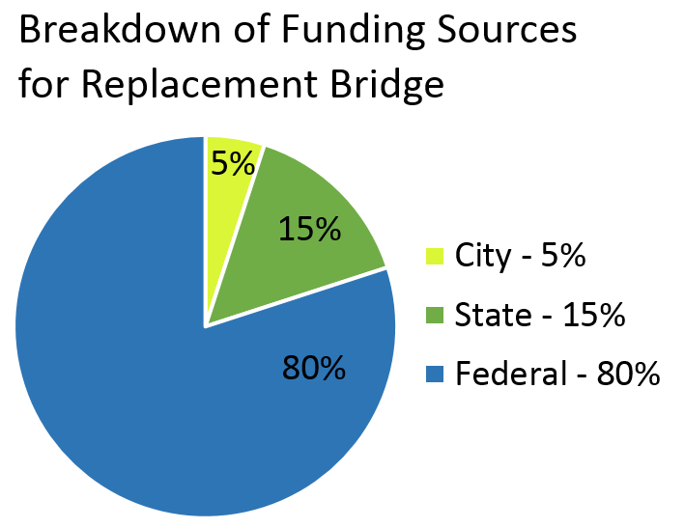
Challenge:
Fed Government can do more to encourage Maintenance
Operations and Maintenance responsibility is assigned to State and Local Gov’s - unless emergency retrofit or renewal is required.
The Federal Government has been changing the language included in Federal Transportation Bills since the 1980’s, but unfortunately there is still a wide gap in how funds are allocated between new vs preservation (FHWA 2015; PEW, 2015)

Slide 10
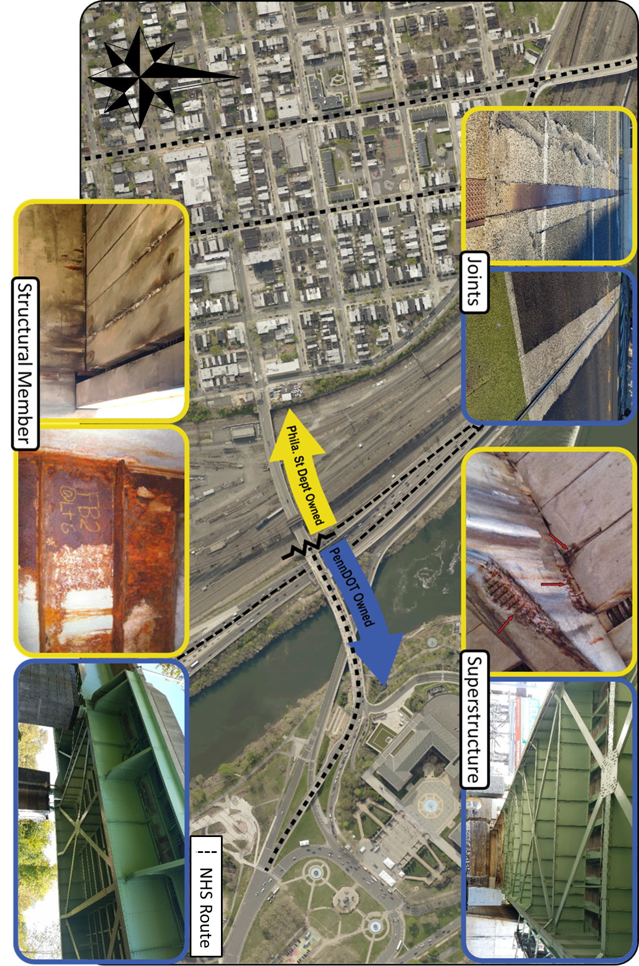
Different Ownership Across the Spring Garden Street
Viaduct – State Segment Restored 2015

Slide 11
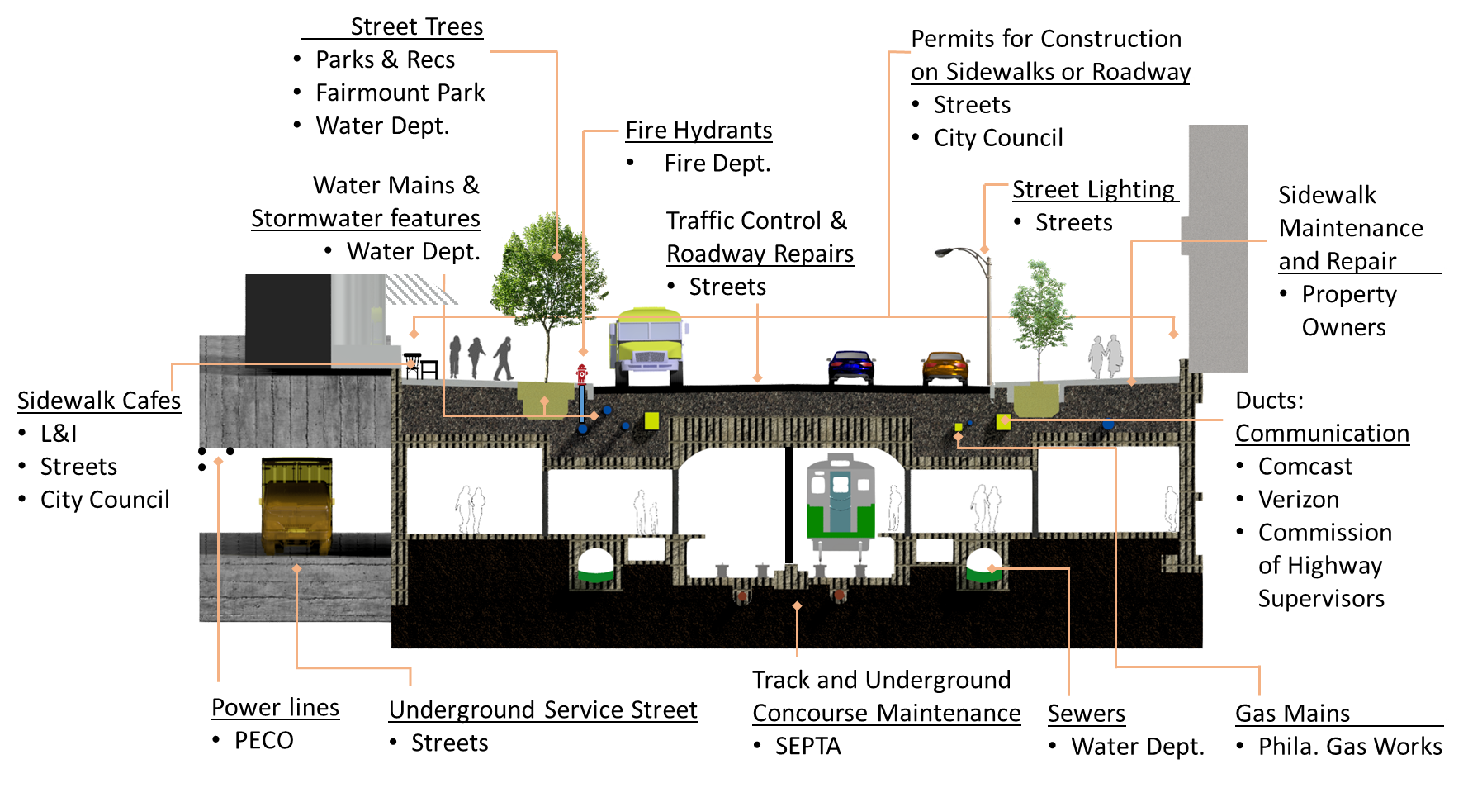
Challenge: Complete Care of a City Street
Cross-section of East Market Street with Assets and Responsible Steward
Ownership of Philadelphia's Streets
7 – Government Agencies
2 - Quasi-governmental agencies
4- Private Owners
1 – Local Law Making Entity
(PlanPhilly.com)
Notes:
To demonstrate the complexity of the manner no fewer than nine government and quasi-governmental agencies (plus a few private entities) that are responsible for the maintenance and operations of Philadelphia’s streets (Saksa, 2015b).
The diverse needs and priorities of the varying stakeholders creates an environment of chaos where coordination is staying out of the way of the other, rather than working together to solve common problems.

Slide 12
A Way Forward
Data driven policies and actions
Pros:
Transparency
Lower Life Cycle Costs
Performance Driven Outcomes
…
Cons:
Large Initial Investments
Agency Resistance to Change
Sociotechnical Concerns
Socially connected issues never have an optimal solution for everyone.
How are priorities established?
How do the trade-offs effect the multi-domain metrics?
Political Election Cycles << Asset Life-Span

Slide 13
TAMP SUB_TREE

Slide 14
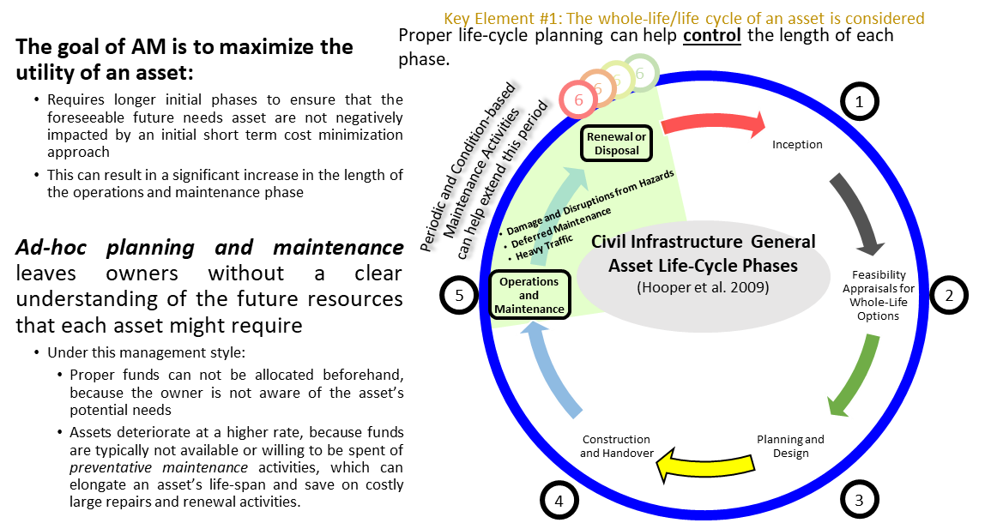
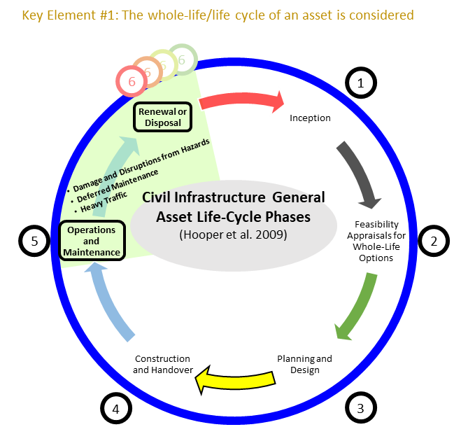
Life-Cycle Phases
The goal of AM is to maximize the utility of an asset:
Requires longer initial phases to ensure that the foreseeable future needs asset are not negatively impacted by an initial short term cost minimization approach
This can result in a significant increase in the length of the operations and maintenance phase
Ad-hoc planning and maintenance
leaves owners without a clear understanding of the future resources that each asset might require
Under this management style:
Proper funds can not be allocated beforehand, because the owner is not aware of the asset’s potential needs
Assets deteriorate at a higher rate, because funds are typically not available or willing to be spent of preventative maintenance activities, which can elongate an asset’s life-span and save on costly large repairs and renewal activities.
Key Element #1: The whole-life/life cycle of an asset is considered
6
6
6
6
1
Inception
Feasibility Appraisals for Whole-Life Options
Planning and Design
Construction and Handover
Operations and Maintenance
Renewal or Disposal
Damage and Disruptions from Hazards
Deferred Maintenance
Heavy Traffic
Civil Infrastructure General Asset Life-Cycle Phases
(Hooper et al. 2009)
5
2
Proper life-cycle planning can help control the length of each phase.
Periodic and Condition-based Maintenance Activities
can help extend this period
4
3
Notes:
Hooper, R., Armitage, R., Gallagher, A., & Osorio, T. (2009). Whole-life infrastructure asset management: good practice guide for civil infrastructure. Construction Industry Research and Information Association report C, 677.
Properly timed and coordinated routine and preservation activities can help extend the time period between 5 and 6

Slide 15
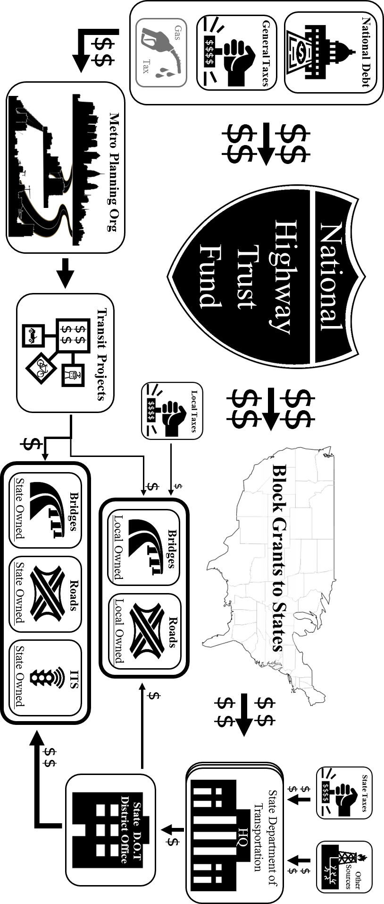
How Does the Money Flow into State and Local Bridges?
Notes:
https://www.fhwa.dot.gov/fastact/summary.cfm Surface Transportation Block Grant Program [1109]

Slide 16
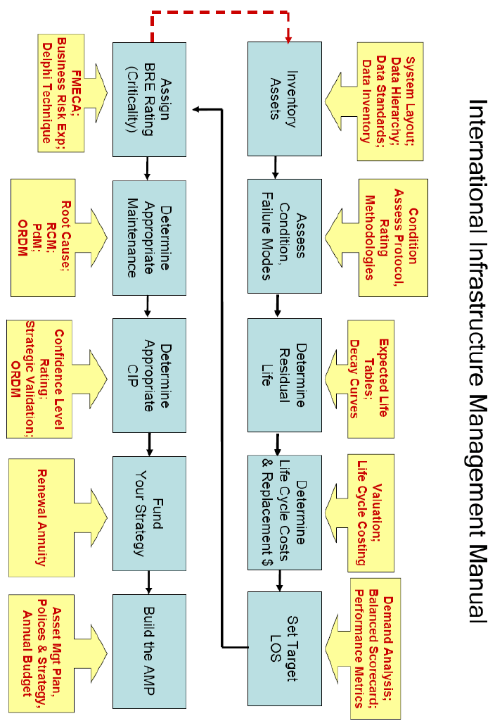
Infrastructure Asset Management Flow Chart

Slide 17
Other TAMP Strategies

Slide 18



Key Elements of Infrastructure Asset Management
FHWA/Asset
Taking a life-cycle approach
The whole-life/life cycle of an asset is considered
Developing cost-effective management strategies for the long-term
Optimization - maximizing benefits by balancing competing demands
resource allocation - allocation of resources based on asset needs
Providing a defined level of service and monitoring performance
Customer Focus - explicit consideration of customer expectations
Understanding and meeting the impact of growth through demand management and infrastructure investment
Managing risks associated with asset failures
Sustainable use of physical resources
Continuous improvement in asset management practices
Key Elements of Infrastructure Asset Management
Notes:
https://www.youtube.com/watch?v=EoifrJNShQg&feature=youtu.be – SEPTA assets moving – full day
strategic approach - a systematic process that takes
a long-term view
l> whole of life - the whole-life/life cycle of an asset is considered
l> optimisation - maximising benefits by balancing competing demands
l> resource allocation - allocation of resources based on asset needs
l> customer focus - explicit consideration of customer expectations.
Hooper, R., Armitage, R., Gallagher, A., & Osorio, T. (2009). Whole-life infrastructure asset management: good practice guide for civil infrastructure. Construction Industry Research and Information Association report C, 677.

Slide 19
SUMO Road Network Levels of Service
Average Travel Speed - hourly
Asset & Network – Table B-4
Signalized Intersections – Table B-6
ADA Compliant – binary
State of Repair
Average for network
Current after period_i and rate of change from period_i -1 and period_i

Slide 20
SUMO Road Network Performance Measures
3.7 Use of Performance Measures
Providing Feedback for Use in Resource Allocation
Structured Feedback Process
Quarterly Management Reviews
Public Feedback
Activity Adjustments Based on an Analysis of Trends
Tradeoff Analysis
Notes:
http://onlinepubs.trb.org/onlinepubs/nchrp/nchrp_rpt_551.pdf
Structured Feedback Process—An example of a structured approach is contained within Florida DOT’s asset management process, which is referred to as a “Continuous Cycle Approach” (Figure 4). Plans and policies are established through the Florida Transportation Plan and the ShortRange Component. Financial polices are established in the Program and Resource Plan. Five-year projects are programmed in the Five-Year Work Program, and, finally, performance is measured. The results of the performance monitoring affect the development of long- and shortrange plans through adjustment of policies.

Slide 21
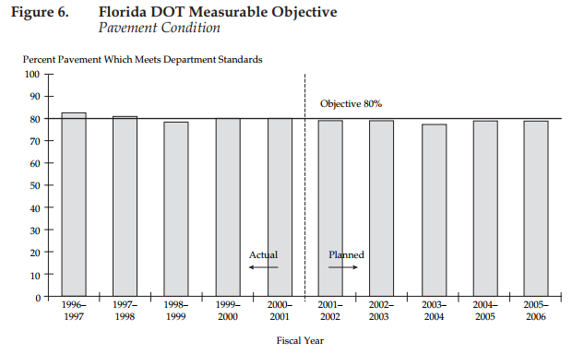
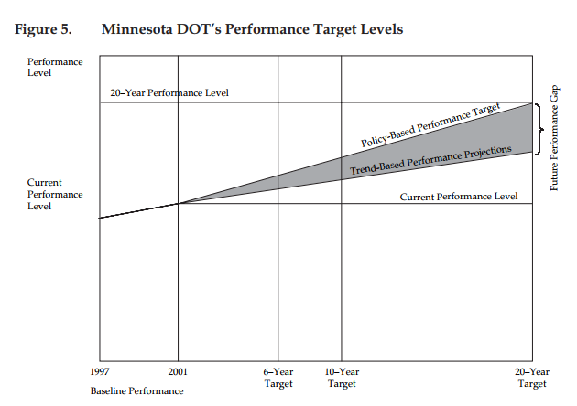
3.8 Setting Performance Targets
Anticipated funding level through the forecast horizon (Idaho, Michigan, Minnesota, Montana, Ohio, New York, and Washington);
Public involvement (Michigan and Montana) and customer-based market research (Minnesota);
Existing condition (Montana), historical performance trend (Minnesota), limited information on performance compared with other states (Minnesota), and the implications of different proposed condition levels (Idaho);
Input from the DOT director, the transportation commission or board, governor’s office, or state legislature (Michigan with Ohio);
Policy goals/guidance and statewide priorities such as “preservation first” (Florida, New York, and Iowa);
Discussion with the construction industry (Michigan);
Life-cycle costs (if a model is available), marginal value of additional investment (100-percent targets are not always advisable) and tradeoff considerations (Minnesota); and
Priorities by route classification (Iowa)

Slide 22
The “How” of TAMP Development
TAMP Section | Development Topics
3. Performance Gap Identifications | If performance targets do not exist, what approach should we use to Identification develop them?
 | How will we incorporate expected revenues into the target setting process?
 | What information would we like to provide decision makers?
 | Who should be involved in the target setting process?
 | Are we confident in the future traffic projections needed to model future asset conditions? If not, how can we improve them in the short and/or long term?
 | Are we going to separate the analysis by functional class? For example are we going to develop separate targets for the Interstate system, and the rest of the NHS?
 | How will we address the relationship between routine maintenance and capital activities/funding?
 | How will address the relationship between asset management activities and system expansion activities/funding?
Notes:
https://www.fhwa.dot.gov/asset/tamp/workplan.pdf

Slide 23
The “How” of TAMP Development
TAMP Section | Development Topics
4. Lifecycle Cost | How will we incorporate lifecycle costs into the TAMP? Considerations
 | Are they reflected in the management systems that we will use for the analysis?
 | How do we manage our assets from inception to disposal, including construction, maintenance, preservation, rehabilitation, improvement, reconstruction, etc.?
Notes:
https://www.fhwa.dot.gov/asset/tamp/workplan.pdf

Slide 24
The “How” of TAMP Development
TAMP Section | Development Topics
5. Risk Management Analysis | What types of programmatic risks will be addressed in the TAMP?
 | What is the best way to determine their likelihood and consequences and to identify risk mitigation strategies? (For example, by convening a risk assessment workshop with representatives from throughout the agency.)
 | What types of system risks should be considered? (For example, performance failure, weather events, etc.)
 | How should we assess system risks? How should the results be presented? (For example, in a statewide map identifying high/med/low risk corridors.)
 | How will we incorporate the results of the system risk assessment into the TAMP? (For example, will our investment strategies vary depending on the level of risk? Will the risk mitigation strategies be combined with or compete against our other asset management strategies?
Notes:
https://www.fhwa.dot.gov/asset/tamp/workplan.pdf

Slide 25
The “How” of TAMP Development
TAMP Section | Development Topics
6. Financial Plan | Which portions of the transportation budget will be included in the financial plan?
 | How will the anticipated level of these funds be determined?
 | Will we allocate funds between asset management and other goal areas such as expansion, or will we focus solely on the allocation of asset management funds between assets?
 | What is the value of our assets today? How does it depreciate through the years included in the TAMP.
 | Should we consider potential new sources of revenue in the TAMP? If so, which ones?
Notes:
https://www.fhwa.dot.gov/asset/tamp/workplan.pdf

Slide 26
The “How” of TAMP Development
TAMP Section | Development Topics
7. Investment Strategies | Will the TAMP include a list of specific projects? If so, which ones?
 | Other than specific projects, what types of investment strategy information will we provide? (Examples include: a description of key strategies, average unit costs, typical timing for when each strategy should be considered; and/or a description of how asset management projects are prioritized and programmed.)
 | Which of these items already exist? How should we develop the ones that don’t?
 | How will we will incorporate the results of the risk assessment into our strategies?
 | How will we incorporate life cycle cost considerations into our strategies?
Notes:
https://www.fhwa.dot.gov/asset/tamp/workplan.pdf

Slide 27
The “How” of TAMP Development
TAMP Section | Development Topics
8. Asset Management Process Enhancements | Will we be conducting the Asset Management self assessment survey as part of the TAMP development process?
 | If so, who needs to take the survey? How will we facilitate the survey process?
 | If not, how will we identify our asset management improvement priorities?
 | What information will be provided in the TAMP? (Examples include a summary of the entire survey, a list of the survey items showing the biggest gaps, a list of priority actions categorized as short term and long term, a list of high priority assets to add to the TAMP, etc.)
Notes:
https://www.fhwa.dot.gov/asset/tamp/workplan.pdf

Slide 28
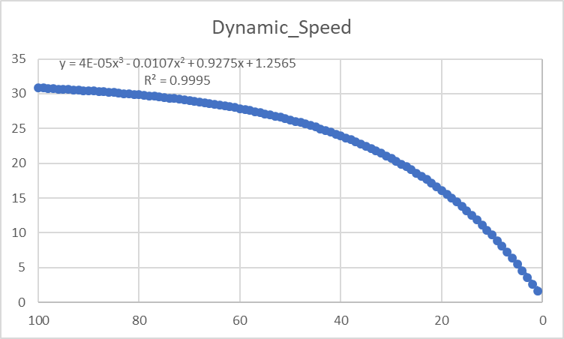

How Condition related to Simulated Speed Limits
SIMULATION’S Max_Speed(PCR)
PCR(t,ESAL,local_conditions)
Each roadway calculates and updates its “Posted Speed Limt” via SUMO’s Traci Python Interface. Due to the difference in driving behavior, some vehicles may still drive a defined percentage above the limit [speedFactor]. [Link to Vehicle Parameters]
Link to traci_Python Git_Hub Repository

Slide 29
Using TraCI
http://sumo.dlr.de/wiki/TraCI
Protocol specification
Please see the TraCI Protocol Specification (including Basic Flow, Messages, Data Types).
TraCI Commands
Control-related commands: perform a simulation step, close the connection, reload the simulation.
For the following APIs, the ID is equal to the ID defined in SUMO's input files. Here, you find their general structure.
Value Retrieval
Induction Loop Value Retrieval retrieve information about induction loops
Lane Area Detector Value Retrieval retrieve information about lane area detectors
Multi-Entry-Exit Detectors Value Retrieval retrieve information about multi-entry/multi-exit detectors
Traffic Lights Value Retrieval retrieve information about traffic lights
Lane Value Retrieval retrieve information about lanes
Vehicle Value Retrieval retrieve information about vehicles
Person Value Retrieval retrieve information about persons
Vehicle Type Value Retrieval retrieve information about vehicle types
Route Value Retrieval retrieve information about routes
PoI Value Retrieval retrieve information about points-of-interest
Polygon Value Retrieval retrieve information about polygons
Junction Value Retrieval retrieve information about junctions
Edge Value Retrieval retrieve information about edges
Simulation Value Retrieval retrieve information about the simulation
GUI Value Retrieval retrieve information about the simulation visualization
State Changing
Change Lane State change a lane's state
Change Traffic Lights State change a traffic lights' state
Change Vehicle State change a vehicle's state
Change Person State change a persons's state
Change Vehicle Type State change a vehicle type's state
Change Route State change a route's state
Change PoI State change a point-of-interest's state (or add/remove one)
Change Polygon State change a polygon's state (or add/remove one)
Change Edge State change an edge's state
Change Simulation State change the simulation
Change GUI State change the simulation visualization
Subscriptions
TraCI/Object Variable Subscription
TraCI/Object Context Subscription
Accessing Generic Parameters

Slide 30
Theatrical Capacity of Roadways
Click for new presentation

Slide 31
TAMP SUB_TREE

Slide 32
SUMO_SUB_TREE
Contents
[hide]
1 Vehicles and Routes
1.1 Repeated vehicles (Flows)
1.2 Routes
1.3 Incomplete Routes (trips and flows)
1.3.1 Traffic assignement zones (TAZ)
1.4 A Vehicle's depart and arrival parameter
1.4.1 depart
1.4.2 departLane
1.4.3 departPos
1.4.4 departSpeed
1.4.5 arrivalLane
1.4.6 arrivalPos
1.4.7 arrivalSpeed
2 Vehicle Types
2.1 Speed Distributions
2.2 Vehicle Length
2.3 Abstract Vehicle Class
2.4 Vehicle Emission Classes
2.5 Impatience
2.5.1 Impatience when passing an intersection without right-of-way
2.5.2 Impatience when lane-changing
2.6 Visualization
2.7 Car-Following Models
2.7.1 Default Krauss Model Description
2.8 Lane-Changing Models
2.9 Junction Model Parameters
2.10 Default Vehicle Type
3 Route and vehicle type distributions
4 Stops
5 Colors
6 Devices

Slide 33
SUMOwiki - Definition of Vehicles, Vehicle Types, and Routes
http://sumo.dlr.de/wiki/Definition_of_Vehicles,_Vehicle_Types,_and_Routes#Speed_Distributions
Contents
[hide]
1 Vehicles and Routes
1.1 Repeated vehicles (Flows)
1.2 Routes
1.3 Incomplete Routes (trips and flows)
1.3.1 Traffic assignement zones (TAZ)
1.4 A Vehicle's depart and arrival parameter
1.4.1 depart
1.4.2 departLane
1.4.3 departPos
1.4.4 departSpeed
1.4.5 arrivalLane
1.4.6 arrivalPos
1.4.7 arrivalSpeed
2 Vehicle Types
2.1 Speed Distributions
2.2 Vehicle Length
2.3 Abstract Vehicle Class
2.4 Vehicle Emission Classes
2.5 Impatience
2.5.1 Impatience when passing an intersection without right-of-way
2.5.2 Impatience when lane-changing
2.6 Visualization
2.7 Car-Following Models
2.7.1 Default Krauss Model Description
2.8 Lane-Changing Models
2.9 Junction Model Parameters
2.10 Default Vehicle Type
3 Route and vehicle type distributions
4 Stops
5 Colors
6 Devices

Slide 34
SUMO_SUB_TREE
Contents
[hide]
1 Vehicles and Routes
1.1 Repeated vehicles (Flows)
1.2 Routes
1.3 Incomplete Routes (trips and flows)
1.3.1 Traffic assignement zones (TAZ)
1.4 A Vehicle's depart and arrival parameter
1.4.1 depart
1.4.2 departLane
1.4.3 departPos
1.4.4 departSpeed
1.4.5 arrivalLane
1.4.6 arrivalPos
1.4.7 arrivalSpeed
2 Vehicle Types
2.1 Speed Distributions
2.2 Vehicle Length
2.3 Abstract Vehicle Class
2.4 Vehicle Emission Classes
2.5 Impatience
2.5.1 Impatience when passing an intersection without right-of-way
2.5.2 Impatience when lane-changing
2.6 Visualization
2.7 Car-Following Models
2.7.1 Default Krauss Model Description
2.8 Lane-Changing Models
2.9 Junction Model Parameters
2.10 Default Vehicle Type
3 Route and vehicle type distributions
4 Stops
5 Colors
6 Devices

Slide 35
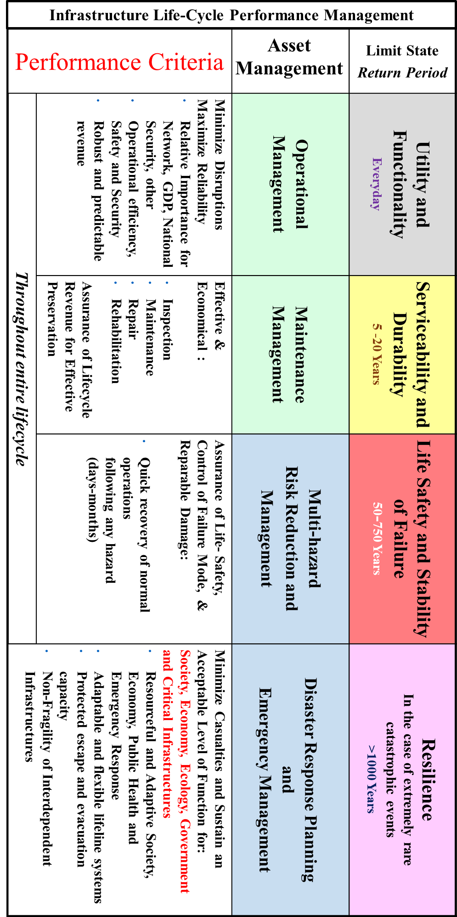
Limit States and Performance Criteria for Whole Life-Cycle Management
Notes:
Really hard to predict consequences of actions that have a long duration

Slide 36
How Will This Model Attack the Problem?
Sociotechnical concerns
Measuring direct feed back from “Users”
Checking for unforeseen consequences.
…
Engineering Optimization
Principles of Operations Research
Linear Programing with objective functions and constraints that reflect the different agencies
Traffic Engineering
Deterioration and Performance Modeling
Performance Metrics

Slide 37
Questions to be answered by Scenarios
What are the impacts of New Development to the immediate surrounding roads and the overall performance of the network?
Set up: Increase demand in a local area
Assessment - Changes In: User Travel-Times and User Experienced Level of Service (ELOS); Asset and Network Performance; Asset Life-Cycle Costs (LCC); Maintenance Activities
How should assets be prioritized for resilience retrofitting to reduce the impact from extreme weather events? (Flooding)
Set up: Remove roadways that are within the 500 year flood plane;
Assessment - Changes in traffic patterns; Identify, with multi-objective criteria, critical assets which should be prioritized to ensure maximize network flow and connectivity;
How can the scheduling of maintenance and construction activities impact the immediate surrounding roads and the overall performance of the network?
Set up: Construction Delays – Active road work = road/lane closure; Milled road surface = reduced condition levels to impact max travel speed
Assessment: Under different scheduling methodologies (ad-hoc; asset focused optimization; network focused optimization; socio-technical optimization) – what are the different impacts to Travel-Times and ELOS; Asset and Network Performance; Asset Life-Cycle Costs; Maintenance Activities
How does the variability of future funding effect the management decisions and LCCs?
Set up: During long term planning routine increased or decreased the variability of the next year’s budget. Budget amount and variability will be based on the financing mechanisms available to the owner
Assessment: Are there changes in spending patterns? Are their any significant efficiency gains between different financing structures?
Is there a significant impact from data collection and utilization methods to the network’s performance, ELOS, and owner operational behavior?
Set up: Conduct a sensitivity analysis of the owner agent’s data accuracy (possibility of reporting no change in condition), resolution (how many attributes of each asset are collected; linked to model sophistication), and update frequency (how often is the data refreshed), and predication model sophistication (regional models, simple linear regression model (local data)
Assessment: Are there significant changes to the network’s performance, ELOS, and owner operational behavior?

Slide 38
Recap – Deliverables
Create an ABM of the management of transportation assets in a segment of Philadelphia to assess how the different TAMP factors effect the life-cycle cost of the assets, network performance, and users’ experiences.
The model must have the ability to:
Simulate of user behavior – variable driving parameters, rerouting capabilities,
Capture users’ experience – level of service received from assets per user
Simulate the deterioration of roadway conditions and have the conditions effect the users’ experience
Max Speed a function of condition
Condition a function of equivalent single axle load ESAL and possibly geographical location if the proper models can be found
Closeable lanes to simulate road work
Vary starting parameters to mimic actual condition of existing network and to simulate disruptions caused by natural disasters
Simulate System Level Transportation Asset Management Decision Processes with Owner Agent Framework
Owner agents must be able to develop an action plan based on a variety of inputs and constraints
Roadway condition data; traffic jams; accidents; predicted future needs; political pressure; Threshold Triggered Actions
Multi-variate system performance metrics to base optimization
Individual Asset and Network Cost minimizing; Network Performance Maximization; Maximize User Experience
Capture Sociotechnical and Engineering Interdependencies
Random disruptions (closures, drop in condition rate, etc. related to non-owner related construction work)
Link roadway condition and time lose to user experience
Link user experience to political component of prioritization of maintenance work done to an asset
Notes:
This model must also be able to simulate user behavior and experience, account for the variability and constraints related to the finical components of an operating budget, and incorporate user experience as a feed-back mechanism to exert political pressure.

Slide 39
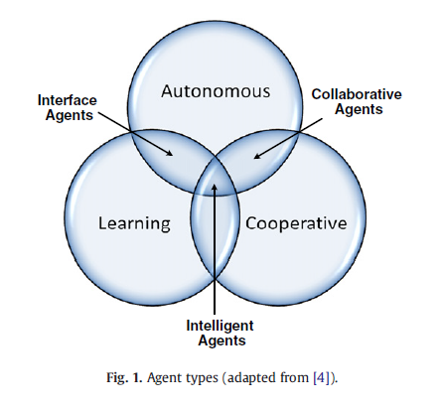
What is Agent Based Modeling?
An agent based model (ABM) utilizes a bottom up approach to define the rules of behavior and interactions for different actors/individuals within a complex adaptable system. The purpose is to simulate the “agents” interactions to observe and study the resulting emergent behavior.
Agents can be thought as an individual software packet that through its interactions with its environment and other agents
Even with simple rules of behavior, complex non-determinate systems can be modeled
Agents typically have three basic functionalities, the ability to operate autonomously, cooperatively, and learn from their encounters. An intelligent agent has all three capabilities (Osman, H. 2012).
This model will contain many different dynamic components, but the owners, and potentially elected officials, will be the only true intelligent agent
The other components being the users and infrastructure assets have dynamic behavior and respond to their environment and interactions
User’s operate in a cooperative manner. By sharing re-routing information with the network.
Assets will deteriorate based on their geographical location and simulated use
Agent Types (Osman, H 2012)
Notes:
Create an Agent Based Model of the management of transportation assets in a segment of Philadelphia to assess how the current management practice compares to FHWA’s best practices and PennDOT’s actual Transportation Asset Management Plan (TAMP)
The novelty of this research is that the deterioration of the assets is a continuous function of the simulated use. The current approach to predicting the future needs of an asset utilizes probability based transition matrices within the Markov Chain process. However, this method lacks the ability to account for deviations from normal patterns due real time asset conditions. Deviations of normal routes create additional loads on adjacent streets. Without accounting for the cause and effect of traffic patterns, the current models do not provide a true prediction of the costs of allowing an asset to deteriorate to an level of poor state of repair. This method promises to better inform decisions makers on how to prioritize their funds, schedule construction projects, choose appropriate actions to limit the negative impact to users, increase over all network performance, and reduce life cycle costs (LCC).

Slide 40
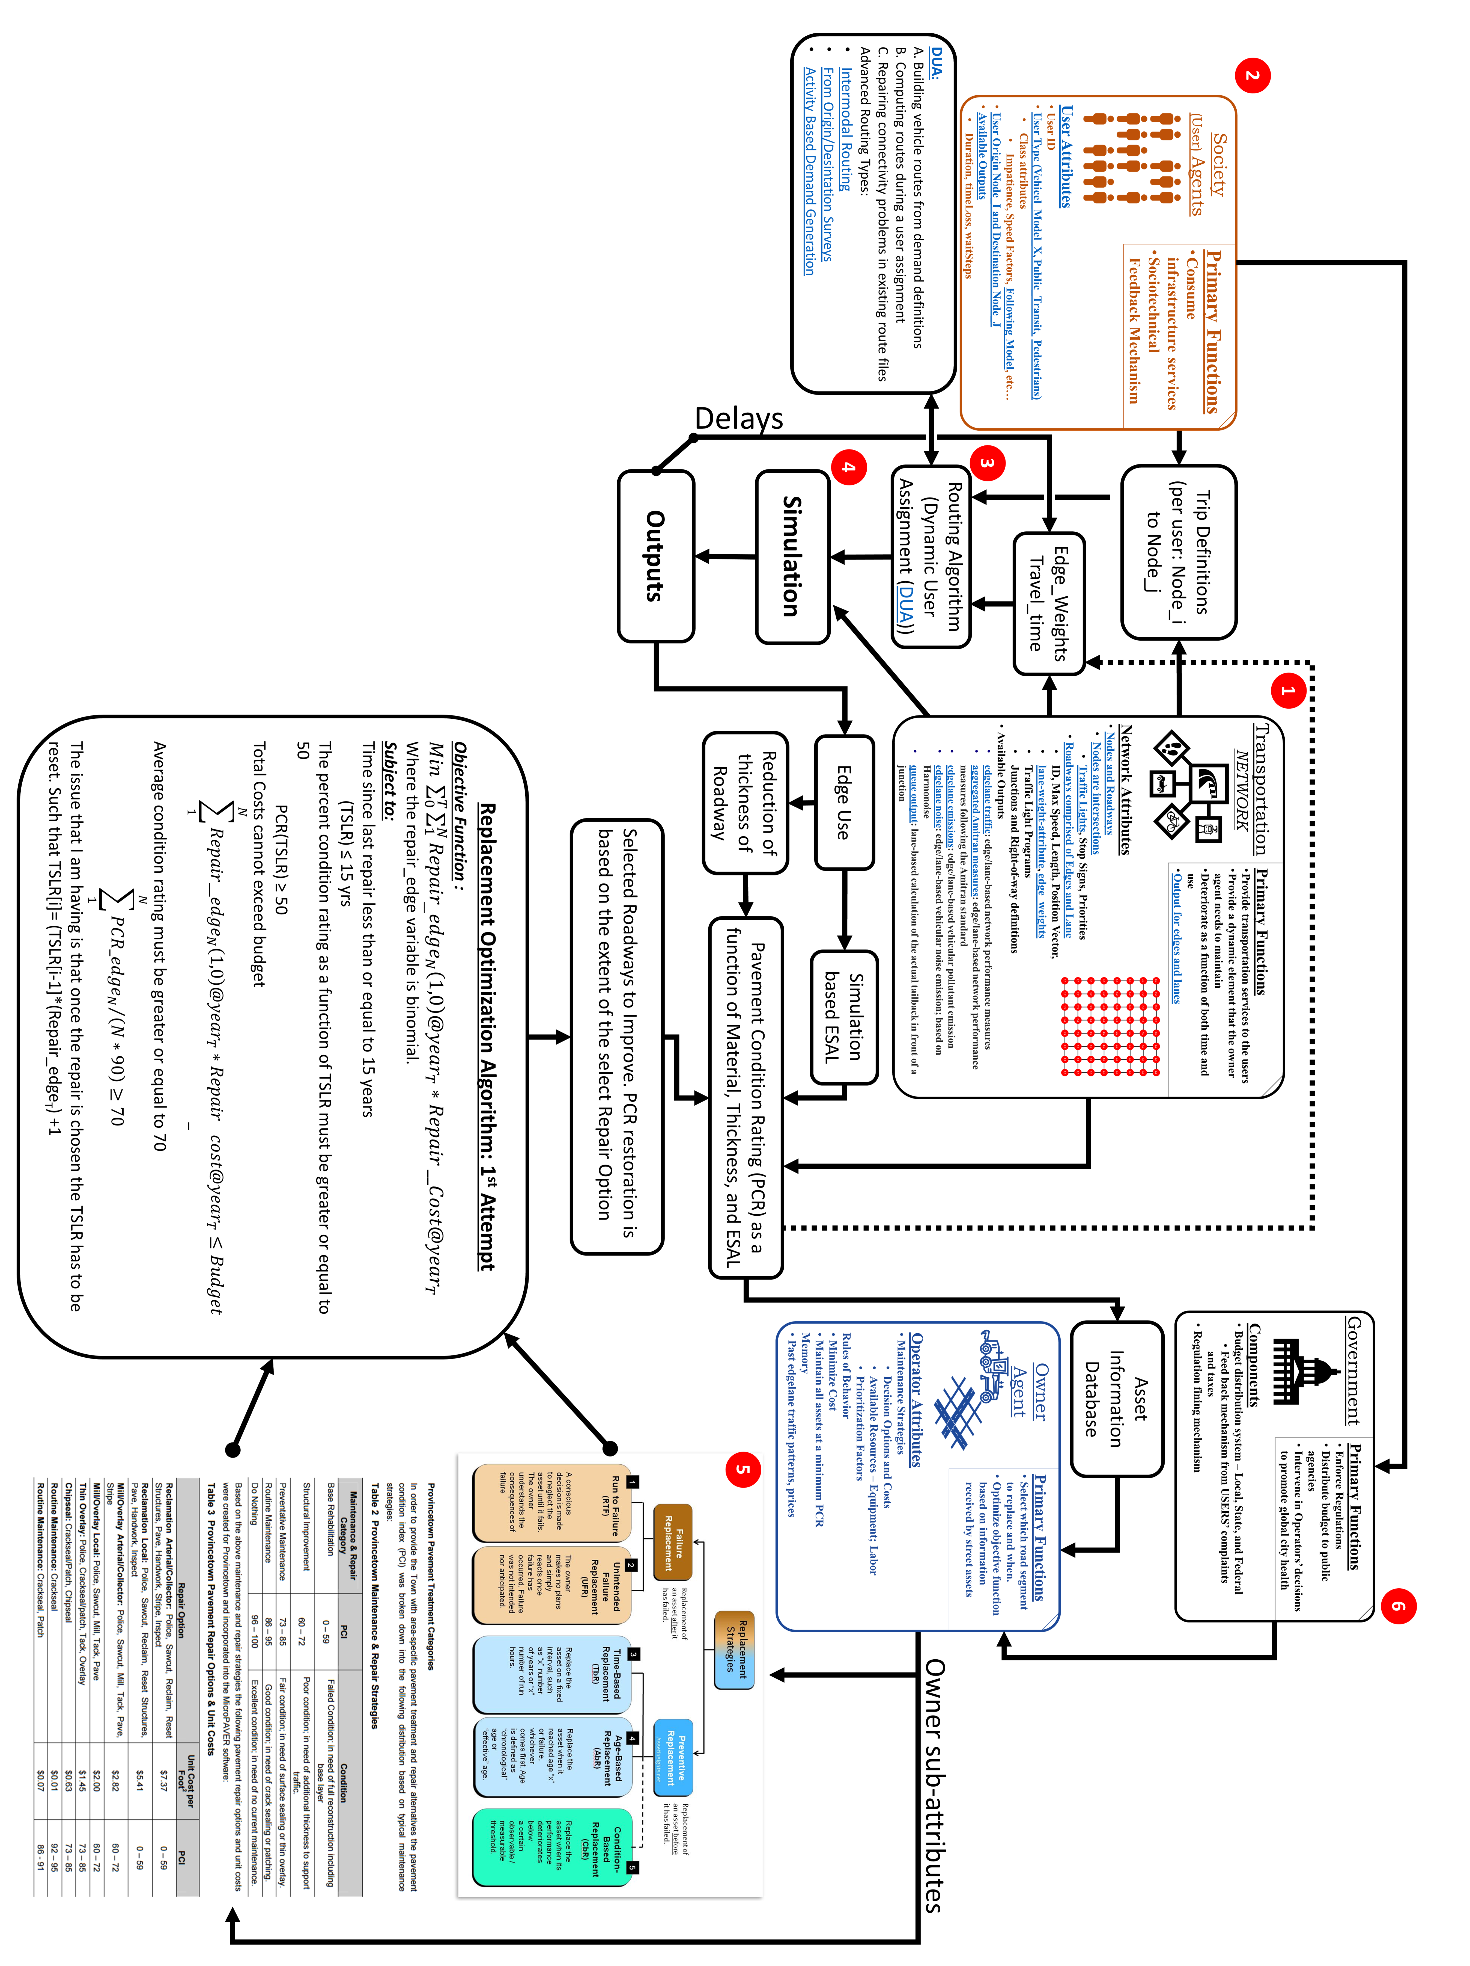
Explain Model Here
file:///C:/Users/Biko/Dropbox/PhD/Papers/Deterioration/Research%20of%20Current%20Practices%20in%20Pavement%20Performance%20Modeling%20-%20PennDOT.pdf
C:\Users\Biko\Dropbox\Asset_Management\Proposal\Simplistic modeling of IAM of urban area script.docx
Notes:
file:///C:/Users/Biko/Dropbox/PhD/Papers/Deterioration/Research%20of%20Current%20Practices%20in%20Pavement%20Performance%20Modeling%20-%20PennDOT.pdf
C:\Users\Biko\Dropbox\Asset_Management\Proposal\Simplistic modeling of IAM of urban area script.docx

Slide 41
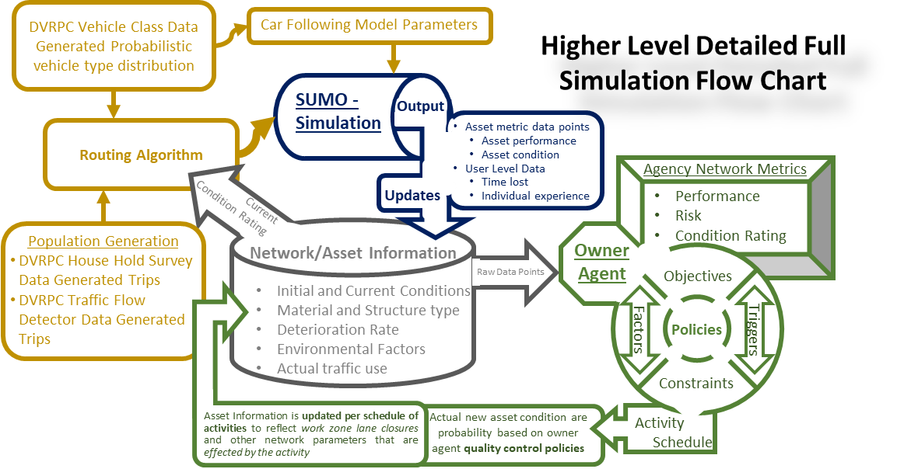
Explain Model Here
file:///C:/Users/Biko/Dropbox/PhD/Papers/Deterioration/Research%20of%20Current%20Practices%20in%20Pavement%20Performance%20Modeling%20-%20PennDOT.pdf
C:\Users\Biko\Dropbox\Asset_Management\Proposal\Simplistic modeling of IAM of urban area script.docx
Notes:
file:///C:/Users/Biko/Dropbox/PhD/Papers/Deterioration/Research%20of%20Current%20Practices%20in%20Pavement%20Performance%20Modeling%20-%20PennDOT.pdf
C:\Users\Biko\Dropbox\Asset_Management\Proposal\Simplistic modeling of IAM of urban area script.docx

Slide 43
What does a Complete Model Look Like
OSM base map of segment of Philadelphia’s Fairmount Park
Traffic – vehicles per hour and vehicle type distributions
Based on DVRPC available traffic count data
Routes – based on heuristics
Deterioration based on the ESAL of the simulated traffic and random events
Need to find a way to incorporate environmental factors for individualized decoration rates
Compare predicted damage (no interventions), based input date, to simulated damage. This will be a critical test to see if SUMO is worth the time and effort.
Owner agent module
Creates work plan schedule to meet predefined goals
Random; Worst First; Corridor; Isolated Asset Group; Combined Asset Management; Service Provided; Multi-Objective Optimization
Constraints: Budget; Politics (geospatial distribution); Organizational
During simulation owner carries out schedule work or reacts to emergency events

Slide 44
Model - Limitations
Trying to simulate a “wicked problem” is inherently inaccurate.
There is no “right” answer to how much detail and complexity needs to be modeled to create a simulation with meaningful results.
I will rely on assumptions and randomness to simulate the interactions between the different systems
Human → Human, Human → Engineered, Engineered → Human, Engineered → Engineered, Natural → Engineered
The output of a single simulation is not meaningful. It will take possible thousands of simulations runs for any discernable emergent behavior patterns that can be used to draw conclusions.
A single day can take many hours to simulate, this will limit the amount of scenarios and permutations of individual scenarios.
Travel patterns within the network are calibrated by traffic count data that is only a snapshot (3 days) in time
There are many factors that lead to the deterioration of an asset, this research will only account for use, weight of vehicle, sun exposure, and pavement structural composition.
I am still searching for a more sophisticated pavement deterioration model.
Limited amount of historic and current condition data, unknown accuracy of data

Slide 46
Components of the Simulation
Graph model of physical network topology – Deterministic and Probabilistic
How many lanes are on each street (edge)? Where as the intersections (nodes) between the length of the street? - Deterministic
Control Systems
What are the control parameters at the different intersections – Traffic Lights (phase timing), Stop Signs, Merging, etc. - Deterministic
Lane designations and permissions – Turning lanes, Bus Lanes, target lanes at junctions - Deterministic
Speed Limits - Deterministic
Pavement deterioration rate – Statistical and Probabilistic
Based on FHWA Pavement Deterioration Models and simulated use
Network Use – Statistical and Probabilistic
User – Car Following Model – Vehicle type differences: accelerations, decelerations, deviation from speed limit, driver imperfection, etc - Probabilistic
Demand – Trips: Who, From, To, When, How?
DVRPC – House Hold Trip Survey Data ~1,700 unique trips - Deterministic
DVRPC – Traffic count data - Statistical
Validation of new trips and data – Statistical
Matching output trends to known traffic patterns - Statistical and Probabilistic
Calibrator tool (adds or removes traffic during the simulation to match count data) - Probabilistic
Simulation – Users + Trips + Network + Control Systems – Network Performance is Non-Deterministic
How were the different assets used? – Current Pavement Condition Rating
How did the network of assets effect the user?
User delayed in jam? User involved in an accident? User arrives significantly later at destination than expected?
Transportation Agency Decision Simulator- Statistical and Probabilistic, but Simulated Emergent Behavior is Non-Deterministic
Notes:
Scope of project – (Deterministic) – soft constraint – Policy driven – example: PWD can not contribute funds to any project that’s scope is outside of their jurisdiction, due to their bonding arrangement.
Owner Agent Rules of behavior are Statistical and Probabilistic, but Simulated Emergent Behavior is Non-Deterministic

Slide 47
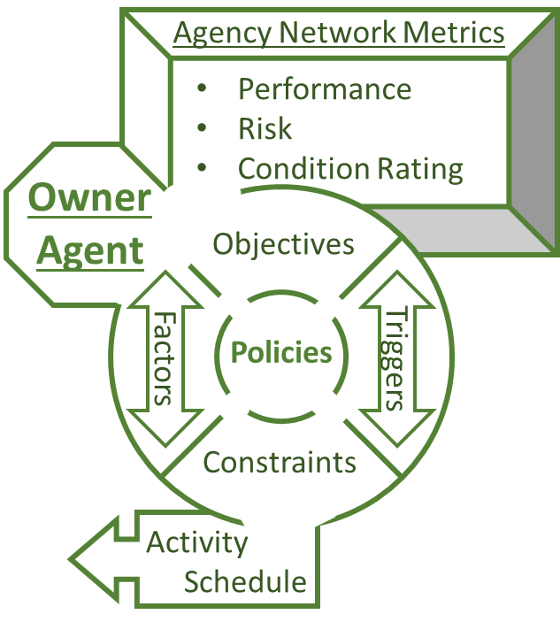
Owner Agent – Tentative Rules of Behavior – Detailed
Rules of behavior
Statistical and Probabilistic, but Simulated Emergent Behavior is Non-Deterministic
Non-linear programing – Schedule Optimizer
Objective function variation: short term cost minimization, overall network performance maximization, LCC minimization, Holistic Livability maximization
Subject to:
Budget – next year’s budget (Probabilistic) – soft constraint
Number of overlapping activities – (Deterministic) – hard constraint – Availability: Labor Force, Equipment, Material In-Stock, Completion time of activity (Probabilistic)
Available activities - (Deterministic) – Work force capabilities
Effectiveness of activity – (Probabilistic) – Variation in condition increase base on quality control practices
Cost of project – (Heuristics and Probabilistic) - variations in material cost based on seasonal adjustments and market fluctuation
Scope of activities – (Deterministic) – soft constraint – Policy driven – example: PWD can not contribute funds to any project that’s scope is outside of their jurisdiction, due to their bonding arrangement.
Condition data:
Probabilistic – Data collection practices → probability inspection data is reported correctly
Deterministic – Data collection practices → condition data update rate
Indirect Deterioration costs – Statistical and Non-Deterministic:
Importance factor: i.e. - Change in vehicle flow rate per year given no maintenance activities and default flow rates.
User experience - Statistical and Non-Deterministic:
Simulated vehicle interactions create differences between the routes expected travel-time and the actual travel time, experience is quantified as the piece-wise integral of the negative intensity over the time period above the threshold.

Slide 48
Owner Agent – Tentative Rules of Behavior
Owner Agent – Rules of behavior are Statistical and Probabilistic, but Simulated Emergent Behavior is Non-Deterministic
Following the FHWA TAMP workplan (2013) and the new FAST Act Rules
Generates a schedule of work orders to be completed during the simulation
Components of Operation Research optimizing objective function with constraints, based on scenario
Owner agent receives information about the transportation assets
Owner types will differ through their optimization parameters, objectives, and constraints
Building and modifying short and long term plans based on non-deterministic simulation network performance.
Data is processed through different metrics and models to help build or modify agency TAMP
Owner agent’s make Transportation Asset Management decisions that directly effect the virtual network
Simulations permits the opportunity to observe the consequences (good or bad) of different management policies and variations in finical and logistical parameters. – Deterministic and Statistical model parameters, but non-deterministic long term behavior

Slide 49
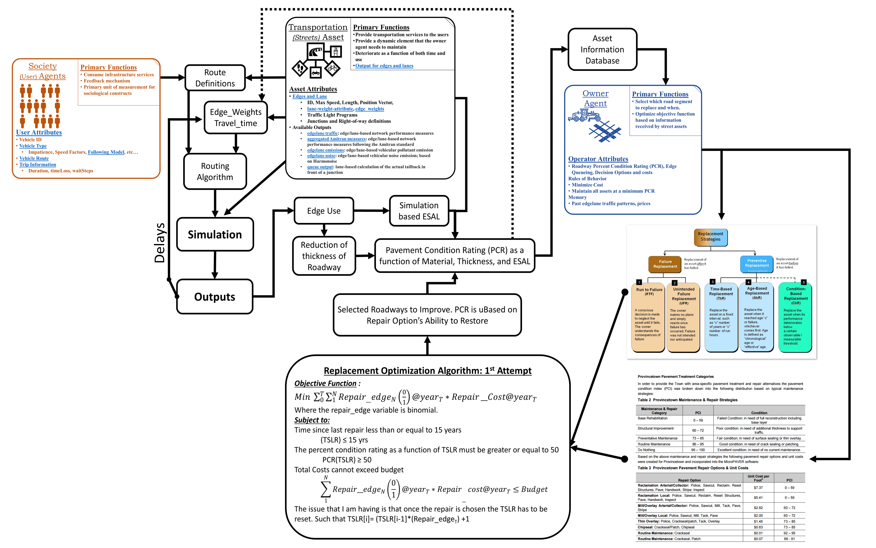
Owner Agent Continued

Slide 50
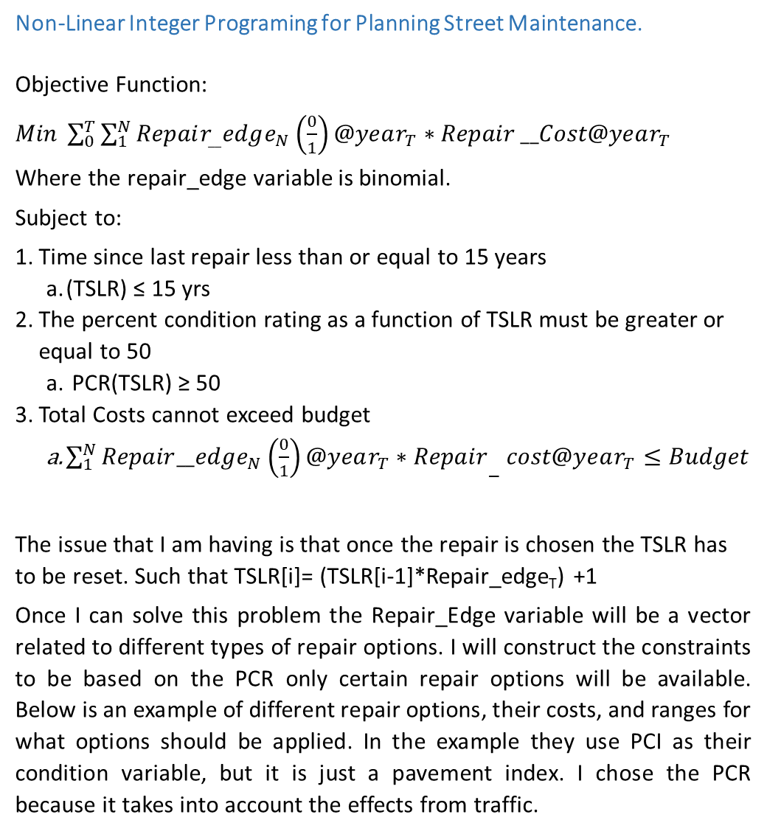
Linear Programing Example
Non-Linear Integer Programing for Planning Street Maintenance.
Objective Function:
$Min \sum_{0}^{T}{\sum_{1}^{N}{Repair_{__}edge_{N}\left(\frac{0}{1}\right)@year_{T}∗Repair}}__Cost@year_{T}$
Where the repair_edge variable is binomial.
Subject to:
Time since last repair less than or equal to 15 years
(TSLR) ≤ 15 yrs
The percent condition rating as a function of TSLR must be greater or equal to 50
PCR(TSLR) ≥ 50
Total Costs cannot exceed budget
${\sum_{1}^{N}{Repair__edge_{N}\left(\frac{0}{1}\right)@year_{T}∗Repair}}_{−}cost@year_{T}≤Budget$
The issue that I am having is that once the repair is chosen the TSLR has to be reset. Such that TSLR[i]= (TSLR[i-1]*Repair_edge_{T}) +1
Once I can solve this problem the Repair_Edge variable will be a vector related to different types of repair options. I will construct the constraints to be based on the PCR only certain repair options will be available. Below is an example of different repair options, their costs, and ranges for what options should be applied. In the example they use PCI as their condition variable, but it is just a pavement index. I chose the PCR because it takes into account the effects from traffic.
Notes:
file:///C:/Users/Biko/Dropbox/PhD/Papers/Deterioration/Research%20of%20Current%20Practices%20in%20Pavement%20Performance%20Modeling%20-%20PennDOT.pdf
C:\Users\Biko\Dropbox\Asset_Management\Proposal\Simplistic modeling of IAM of urban area script.docx

Slide 51
Owner Agent Continued

Slide 52
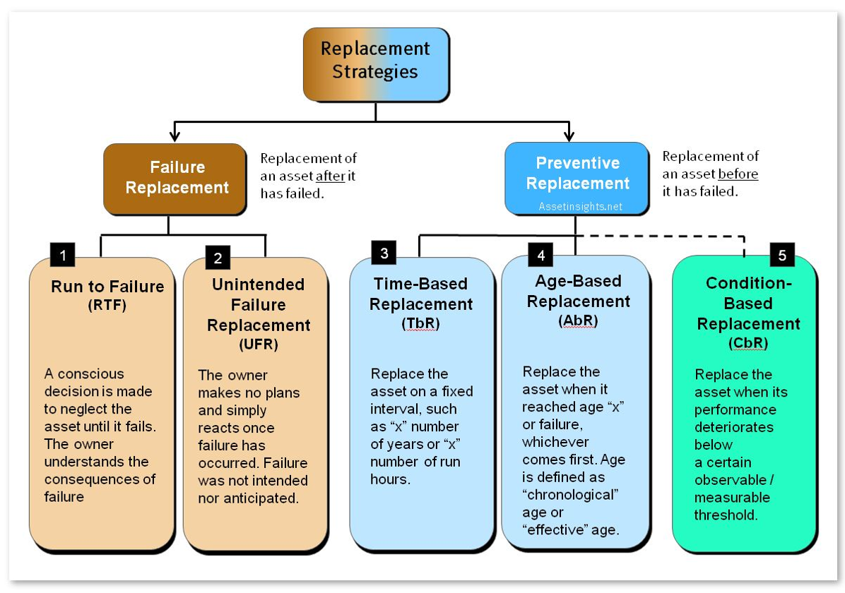
Owner Agent - Replacement Strategies - Example

Slide 53
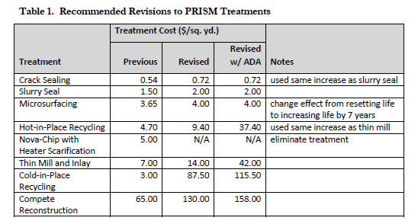
Spy Pond’s Recommendations
Drobox LINK

Slide 54
Next Steps
SUMO (90% complete)
Finalize Traffic flow calibrators for the AOI network (95%)
Link to DVRPC Traffic Count Excel Data Extracted from DVRPC Web App
Incorporated the pavement deterioration function into the SUMO model and have the current condition affect the max speed over the pavement segment. (95%)
Incorporate a user ELOS function based on user travel time, pavement condition, and accident rate to keep track of user experience (85%)
Develop Initial or Changes to Existing Conditions for Scenarios and Assess Changes
Owner Agent – Next Page
Notes:
Future work: Combine DVRPC individual’s trips into linked trips with stops corresponding with reported duration and parking.

Slide 55
Next Steps
Owner Agent (70%) – link to PowerPoint with TAMP framework components – 70%
Translate FHWA’s TAM Framework into the Owner Agent’s operational parameters and functionality
Define and translate the different management principles into a standard linear or non-linear programing format.
Multi-objective constrained optimization: Short-term operations scheduling and Long-term planning
Create a transportation asset management framework and code to interface with the SUMO simulation for managing the transportation assets.
Identify the critical elements from FHWA’s Best Practices and PennDOT’s current TAMP
Conduct interviews with City Streets Department to further map their pavement management process, their constraints, and objectives
Develop decision and finance routines to simulate owner/operator’s behavior.
Incorporate aggregate user experiences to increase political pressure (artificially rising priority) on owner agents to fix bad roads that effect the general public.
Notes:
Future work: Combine DVRPC individual’s trips into linked trips with stops corresponding with reported duration and parking.

Slide 56
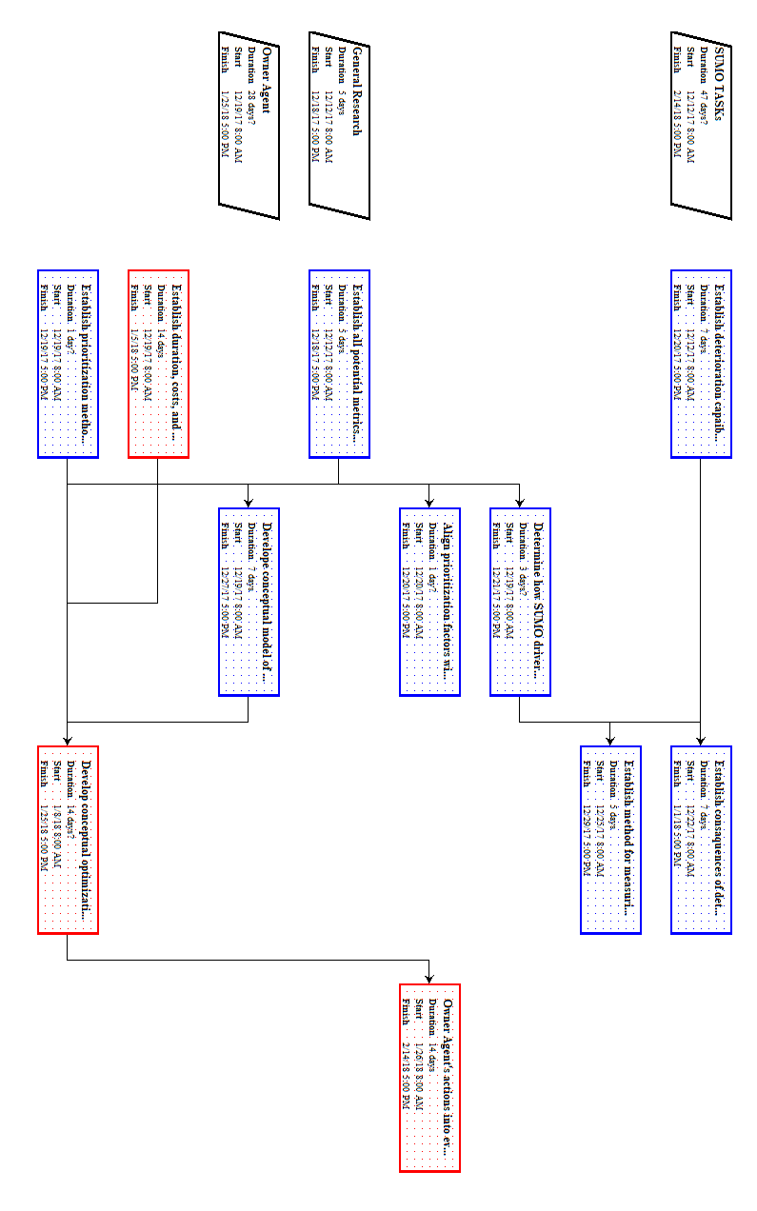
Work Plan

Slide 57
What does a Complete Model Look Like
OSM base map of segment of Philadelphia’s Fairmount Park
Traffic – vehicles per hour and vehicle type distributions
Based on DVRPC available traffic count data
Routes – based on heuristics
Deterioration based on the ESAL of the simulated traffic and random events
Need to find a way to incorporate environmental factors for individualized decoration rates
Compare predicted damage (no interventions), based input date, to simulated damage. This will be a critical test to see if SUMO is worth the time and effort.
Owner agent module
Creates work plan schedule to meet predefined goals
Random; Worst First; Corridor; Isolated Asset Group; Combined Asset Management; Service Provided; Multi-Objective Optimization
Constraints: Budget; Politics (geospatial distribution); Organizational
During simulation owner carries out schedule work or reacts to emergency events

Slide 58
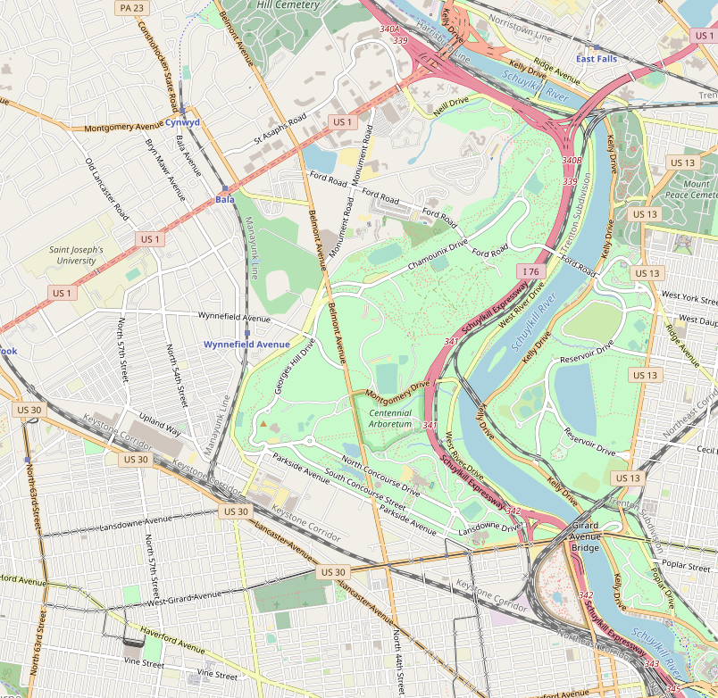
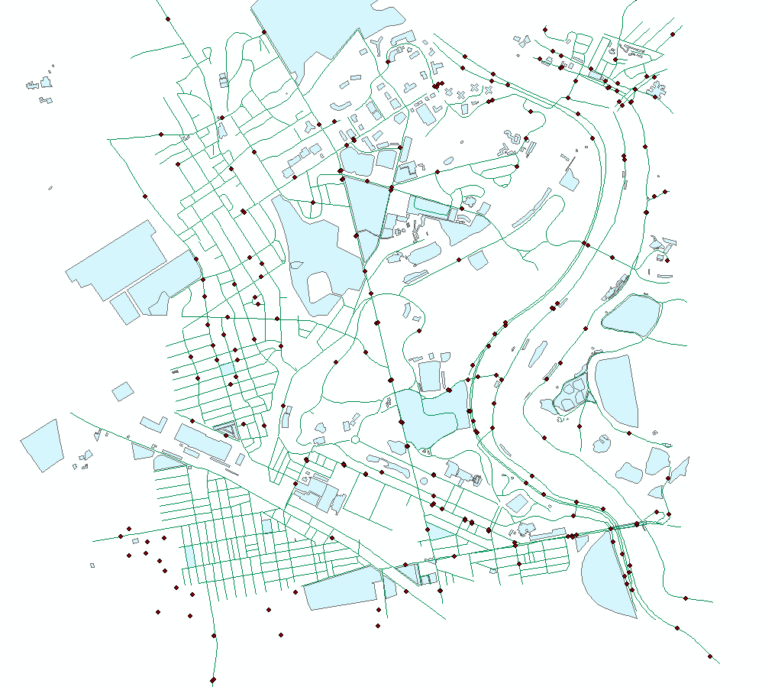
Traffic Modeling AOI - Belmont Ave in West Fairmount Park
Images and process -> C:\Users\Biko\Dropbox\Asset_Management\SUMO\Belmount AOI.pptx
Open Streets Map of Area
DVRPC Traffic Data Points
Notes:
Images and process -> C:\Users\Biko\Dropbox\Asset_Management\SUMO\Belmount AOI.pptx

Slide 59
How is the Simulation Validated?
As with other simulations and models the quality and accuracy of the input data plays a significant factor in the accuracy of the output.
The topology of the network is imported via data from the OpenStreetMap database.
Creating realistic demands to flow across the network is a great deal more complicated.
DVRPC’s House Hold Trip Survey Data is used to generate trips within the network.
DVRPC’s Traffic Count Data is used during the simulation to either increase or decrease the traffic volume to match the historic records
Number of traffic count locations in the AOI = 38
DVRPC’s Vehicle Class Data is used to determine the vehicle type distribution in the simulation
Number of Vehicle Class count locations in the AOI = 3
This data is integrated together to create a defined number of vehicles per hour passing over known streets. The traffic simulator’s Calibrator element reads this information and tries to add or remove vehicles to the network to match the defined flow.
Other parameters such as turning permissions and traffic signal timing, can also be adjusted to match defined flows and field measurements.

Slide 60
Potential Impacts
The research model will not be 100% accuracy.
Goal use hard data and validated rules of behavior to validate the simulation with real life
Simulation must be run many times for patterns of emergent behavior to be established.
Running the simulations under different management principle objects and agency constraints we will be able to analyze how the small local changes can impact the greater network and performance
DVRPC – Has the tools and resources to continue building on their existing Transportation Improvement Models (TIM) to incorporate sociotechnical components to further the mission of improving the Livability, Sustainability, and Resilience of the region.

Slide 61
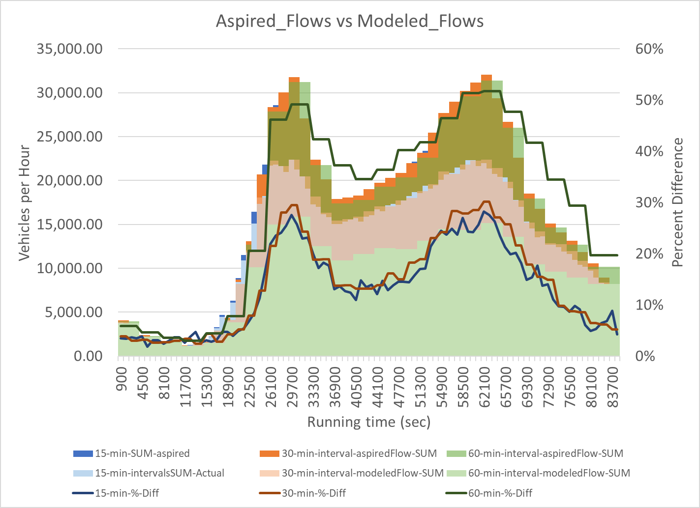
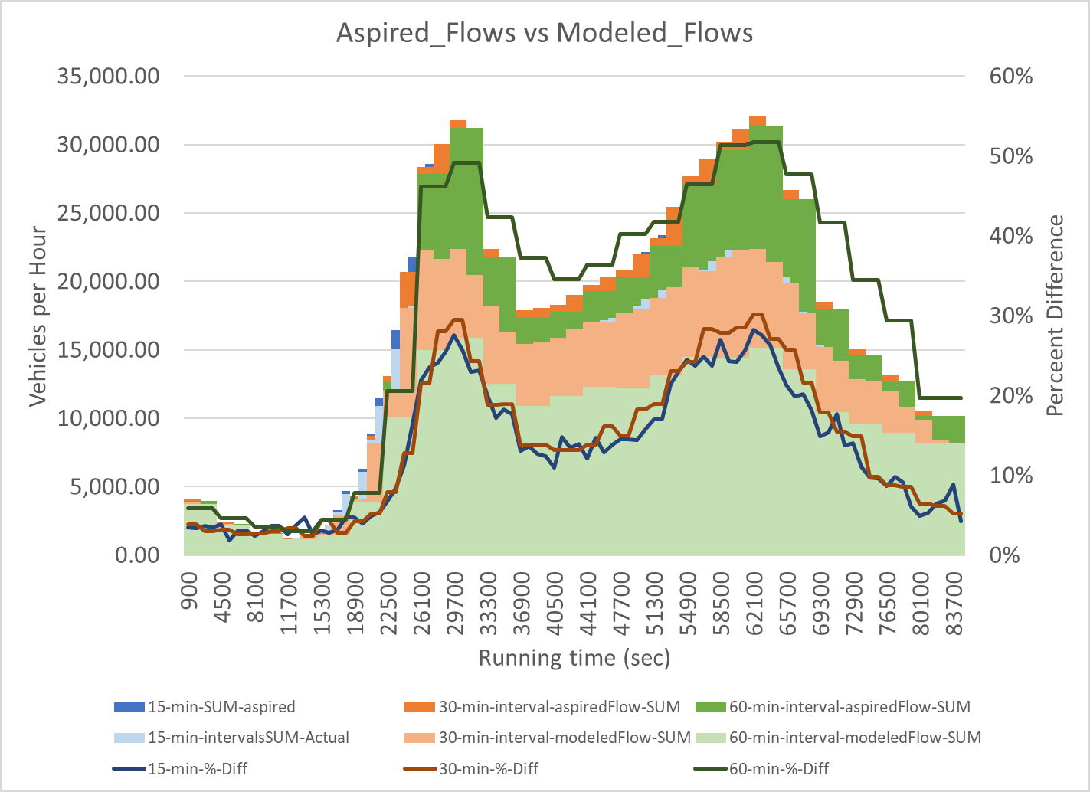
Calibrating the Model
Notes:
C:\Users\Biko\Dropbox\PhD\Research\Models\SUMO\SUMO_DropBox\Belmont_Ave-Run\BMAOI-dropBOX-toolbox\Belmont_AOI-compare_V1-12-6-17.xlsm

Slide 62
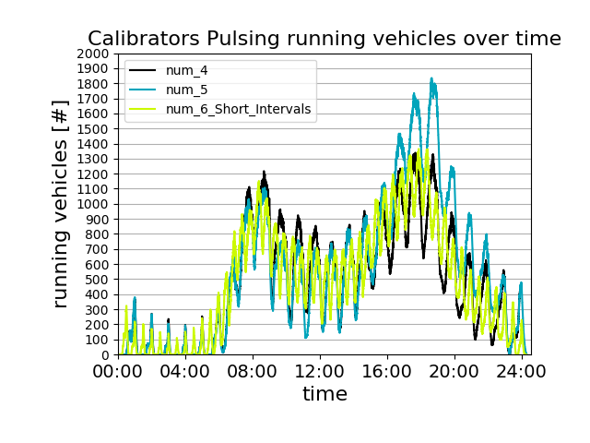
Calibrators

Slide 63
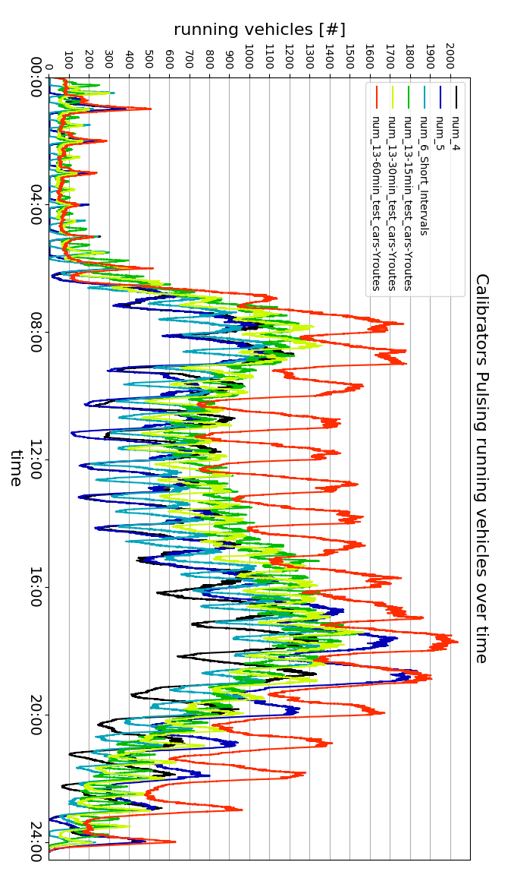
Calibrators

Slide 64

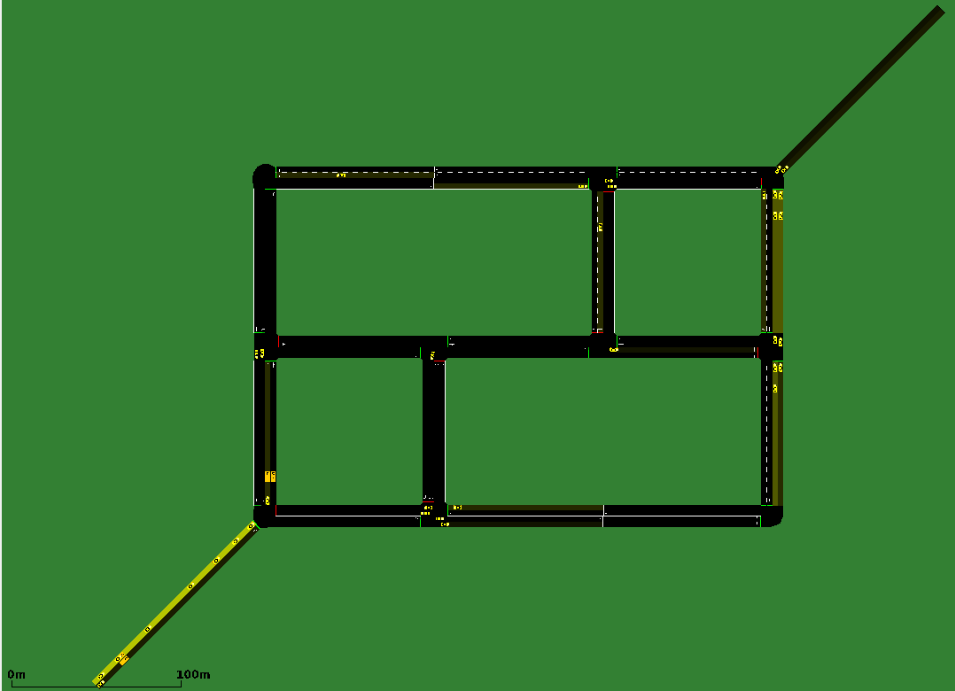
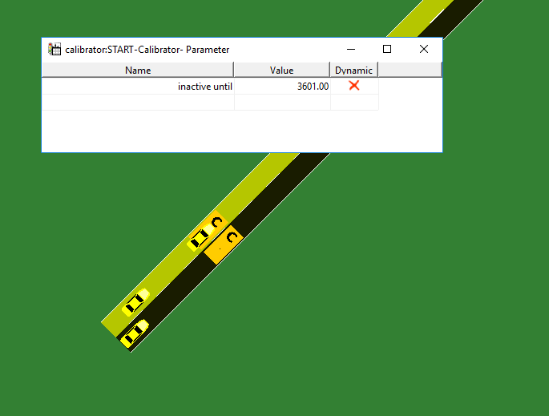
Test Bed for Calibrators

Slide 65
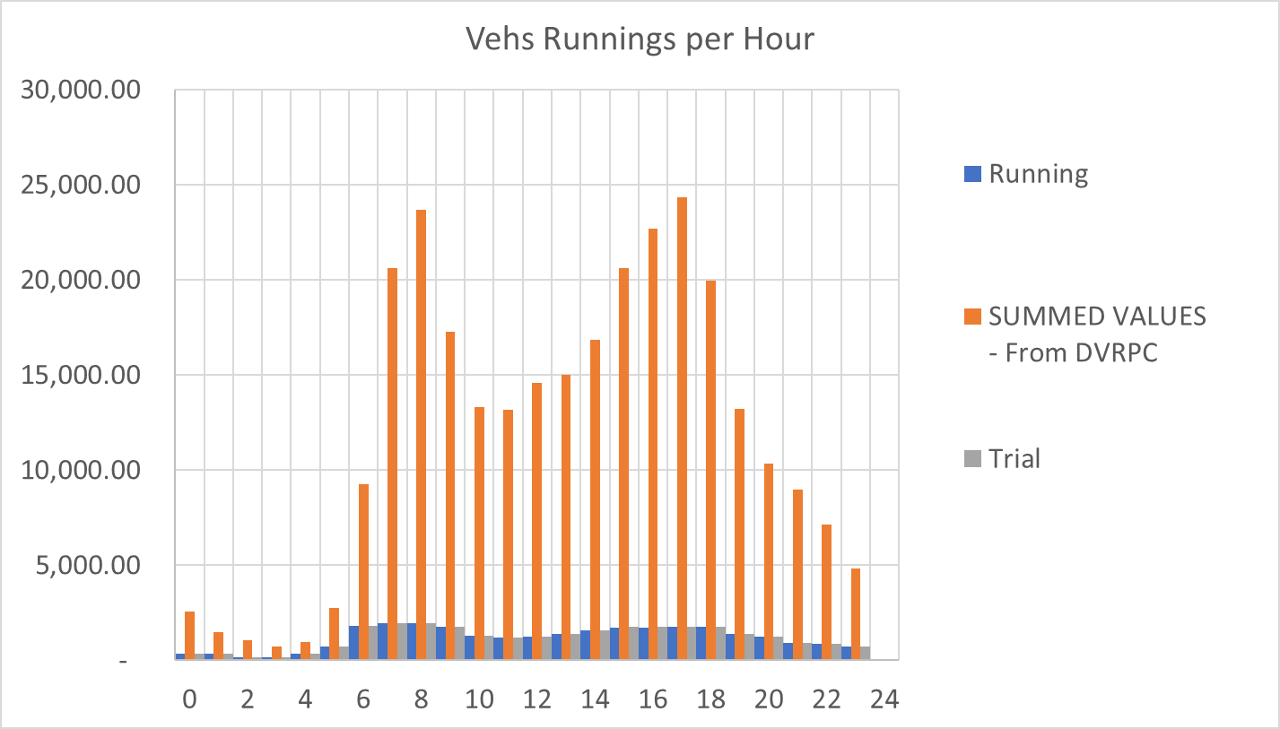
Validation

Slide 66
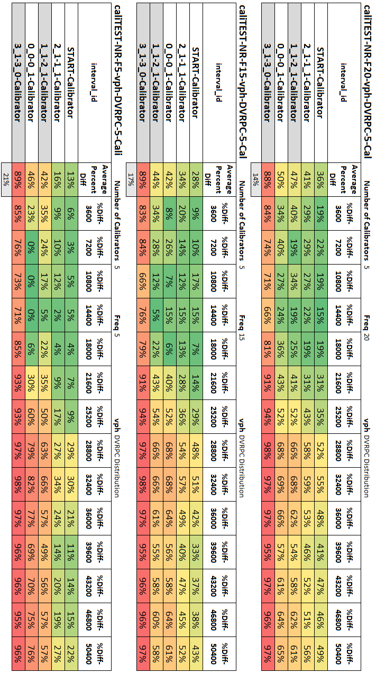
Calibrator Parameters – Parametric Study
Notes:
C:\Users\Biko\Dropbox\Asset_Management\SUMO\SUMO Images and PPs\SUMO-Calibration-Tests-11-16-17.pptm

Slide 67
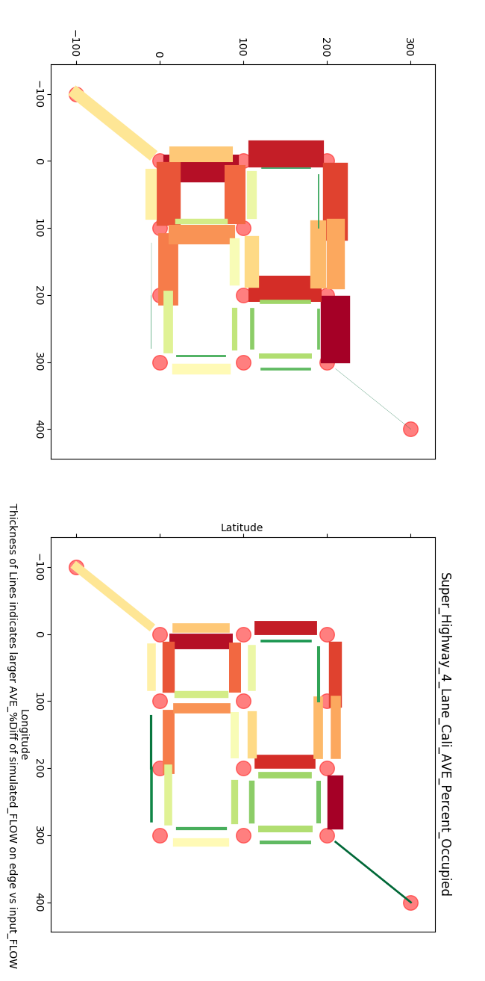
Percent Error – Aspired Flow v Simulated Flow

Slide 68
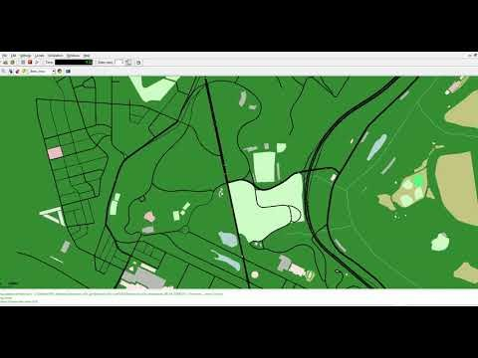
Modeling Traffic along West Belmont Avenue – Philadelphia, PA
Link to video

Slide 69
Owner Agent – Root_Page
Link to Transportation Asset Management Sub_Tree _ Content

Slide 70
Owner Agent – Tentative Rules of Behavior – Detailed
Rules of behavior are Statistical and Probabilistic, but Simulated Emergent Behavior is Non-Deterministic
Non-linear programing – Schedule Optimizer
Objective function variation: short term cost minimization, overall network performance maximization, LCC minimization, Holistic Livability maximization
Subject to:
Budget – next year’s budget (Probabilistic) – soft constraint
Number of overlapping activities – (Deterministic) – hard constraint – Availability: Labor Force, Equipment, Material In-Stock, Completion time of activity (Probabilistic)
Available activities - (Deterministic) – Work force capabilities
Effectiveness of activity – (Probabilistic) – Variation in condition increase base on quality control practices
Cost of project – (Heuristics and Probabilistic) - variations in material cost based on seasonal adjustments and market fluctuation
Scope of activities – (Deterministic) – soft constraint – Policy driven – example: PWD can not contribute funds to any project that’s scope is outside of their jurisdiction, due to their bonding arrangement.
Condition data:
Probabilistic – Data collection practices → probability inspection data is reported correctly
Deterministic – Data collection practices → condition data update rate
Indirect Deterioration costs – Statistical and Non-Deterministic:
Importance factor: i.e. - Change in vehicle flow rate per year given no maintenance activities and default flow rates.
User experience - Statistical and Non-Deterministic:
Simulated vehicle interactions create differences between the routes expected travel-time and the actual travel time, experience is quantified as the piece-wise integral of the negative intensity over the time period above the threshold.

Slide 71
Owner Agent – Tentative Rules of Behavior
Owner Agent – Rules of behavior are Statistical and Probabilistic, but Simulated Emergent Behavior is Non-Deterministic
Following the FHWA TAMP workplan (2013) and the new FAST Act Rules
Owner agent receives information about the transportation assets
Owner types will differ through their optimization parameters, objectives, and constraints
Building and modifying short and long term plans based on non-deterministic simulation network performance.
Data is processed through different metrics and models to help build or modify agency TAMP
Owner agent’s make Transportation Asset Management decisions that directly effect the virtual network
Simulations permits the opportunity to observe the consequences (good or bad) of different management policies and variations in finical and logistical parameters. – Deterministic and Statistical model parameters, but non-deterministic long term behavior

Slide 72
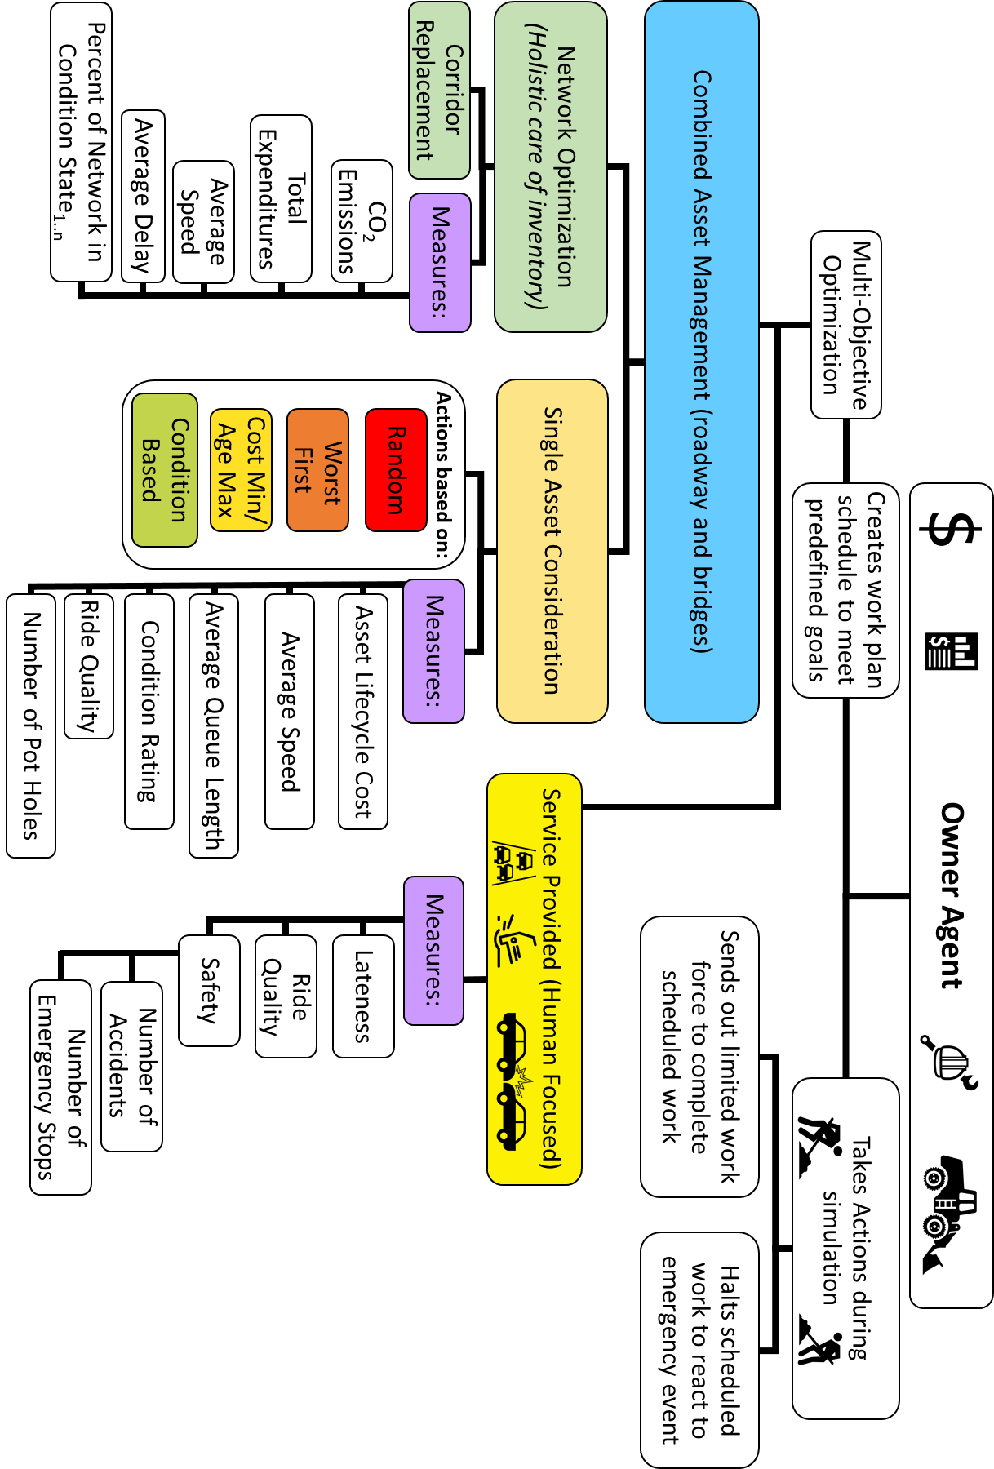
Owner Agent Conceptualization

Slide 73
Owner Agent - Replacement Strategies - Example

Slide 74

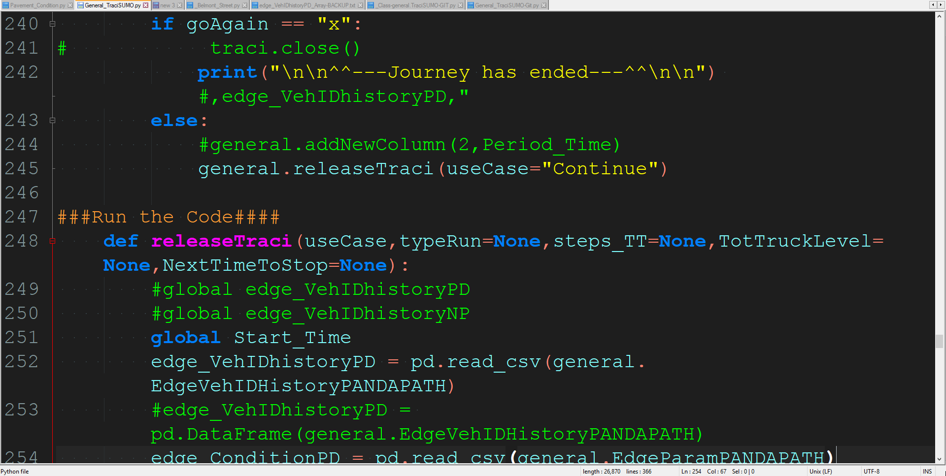
Why SUMO?
My final model will consist of two parts, a traffic simulator and an owner/operator module.
The open source software platform, “Simulation of Urban MObility” (SUMO), will be utilized to simulate the traffic flows. Building off the existing source code, the simulator will collect and update critical information about the type of road, its age, its use, and its condition rating.
The owner and operator module will be developed as a standalone Python based module. The goal of the owner and operator module is to mimic actual maintenance and operational decision processes. The framework from the model will be based on FHWA’s transportation asset management plan (TAMP) best practices guidelines.
Notes:
C:\Users\Biko\Dropbox\Asset_Management\Proposal\DVRPC SUMO vs PT VISUM.pptx

Slide 75


SUMO vs PT Visum
SUMO vs PT VISUM
Similarities
Differences
Each can interface with external Python Code during the simulation.
Can use matrix O/D for demand
Can import external files to generate points of interest (POIs)
Uses traffic analysis zones (TAZ) for routing purposes
Abilities to model multi-modal transportation systems, transportation objects, and user classes
SUMO is an Open Source. Visum is a Professional Software Package.
Open source lends itself to incorporating new rules and behaviors into simulation easier.
SUMO tools are natively written in C++ and Python; adaptation of existing tools is easily accomplished.
SUMO has a wide community of developers creating new tools and improving old tools.
Visum’s add-on Market Place is limited, but contains a more sophisticated traffic engineering modules for modeling the TLS and roadway parameters.

Slide 76
The Dynamic User Assignment Routing Tool
2
DUAROUTER imports different demand definitions, computes vehicle routes that may be used by SUMO using shortest path computation; When called iteratively DUAROUTER performs dynamic user assignment (DUA). This is facilitated by the tool duaiterate.py which converges to an equilibrium state (DUE).
Purpose:
A) Building vehicle routes from demand definitions
B) Computing routes during a user assignment
C) Repairing connectivity problems in existing route files
System: portable (Linux/Windows is tested); runs on command line
Input (mandatory):
A) a road network
B) a demand definition, User trip definitions
Output: Routes usable for SUMO’s simulations

Slide 77
Building a scenario without knowledge of routes, based on traffic count data --- LINK to SUMO.Wiki Documentation---
Generating Traffic Flows
2
Each road where measurements are given should receive a calibrator and a route probe detector. As soon as the first vehicle has passed the route probe detector, the calibrator will be able to use that vehicles route. For the calibrator to be able to function before the first vehicle, it needs a fall back route which just needs to consist of a single road or a series of routes within a distribution.
Notes:
file:///C:\Users\Biko\Dropbox\PhD\Research\Models\SUMO\DVRPC\Traffic%20Counts\Counts%20OSM%202%20-%20V-2\DVRPC%20Traffic%20Counts%20For%20Net%20OSM%202%20-%20V-2_D.xlsm
"C:\Users\Biko\Dropbox\PhD\Research\Models\SUMO\DVRPC\Traffic Counts\33rd and Market Counts.xlsx"
routeProbe id="PA_3_EB_probe" edge="-386547297#1" freq="60" file="output.xml" />
calibrator id="PA_3_EB_Edge" lane="-386547297#1_0" pos="0" outputfile="detector.xml" freq="60" routeProbe="PA_3_EB_probe" >
route id="PA_3_EB_Edge_FB" edges="-386547297#1" />
flow begin="0" end="3600" route="PA_3_EB_Edge_FB" vehsPerHour="1033.33333333333" speed="13.41" type="DVRPC_dist" departPos="free“ departSpeed="max" />
flow begin="3600" end="7200" route="PA_3_EB_Edge_FB" vehsPerHour="1065.66666666667" speed="13.41" type="DVRPC_dist" departPos="free" departSpeed="max" />
/calibrator>
routeProbe id="PA_3_WB_probe" edge="386547297#0" freq="60" file="output.xml" />
calibrator id="PA_3_WB_Edge" lane="386547297#0_0" pos="0" outputfile="detector.xml" freq="60" routeProbe="PA_3_WB_probe" >
route id="PA_3_WB_Edge_FB" edges="386547297#0" />
flow begin="0" end="3600" route="PA_3_WB_Edge_FB" vehsPerHour="739.5" speed="13.41" type="DVRPC_dist" departPos="free" departSpeed="max" />
flow begin="3600" end="7200" route="PA_3_WB_Edge_FB" vehsPerHour="744.5" speed="13.41" type="DVRPC_dist" departPos="free" departSpeed="max" />
/calibrator>

Slide 78
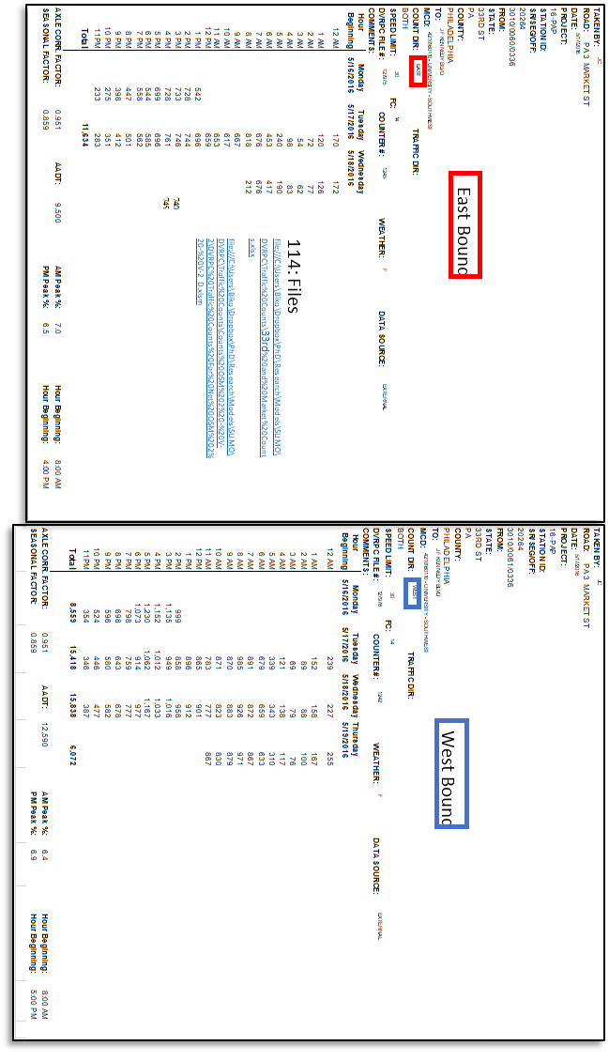
Traffic Count Data -Bad Data Format
33rd and Market Traffic Count Data
East Bound
West Bound
114: Files
file:///C:\Users\Biko\Dropbox\PhD\Research\Models\SUMO\DVRPC\Traffic%20Counts\33rd%20and%20Market%20Counts.xlsx
file:///C:\Users\Biko\Dropbox\PhD\Research\Models\SUMO\DVRPC\Traffic%20Counts\Counts%20OSM%202%20-%20V-2\DVRPC%20Traffic%20Counts%20For%20Net%20OSM%202%20-%20V-2_D.xlsm

Slide 79
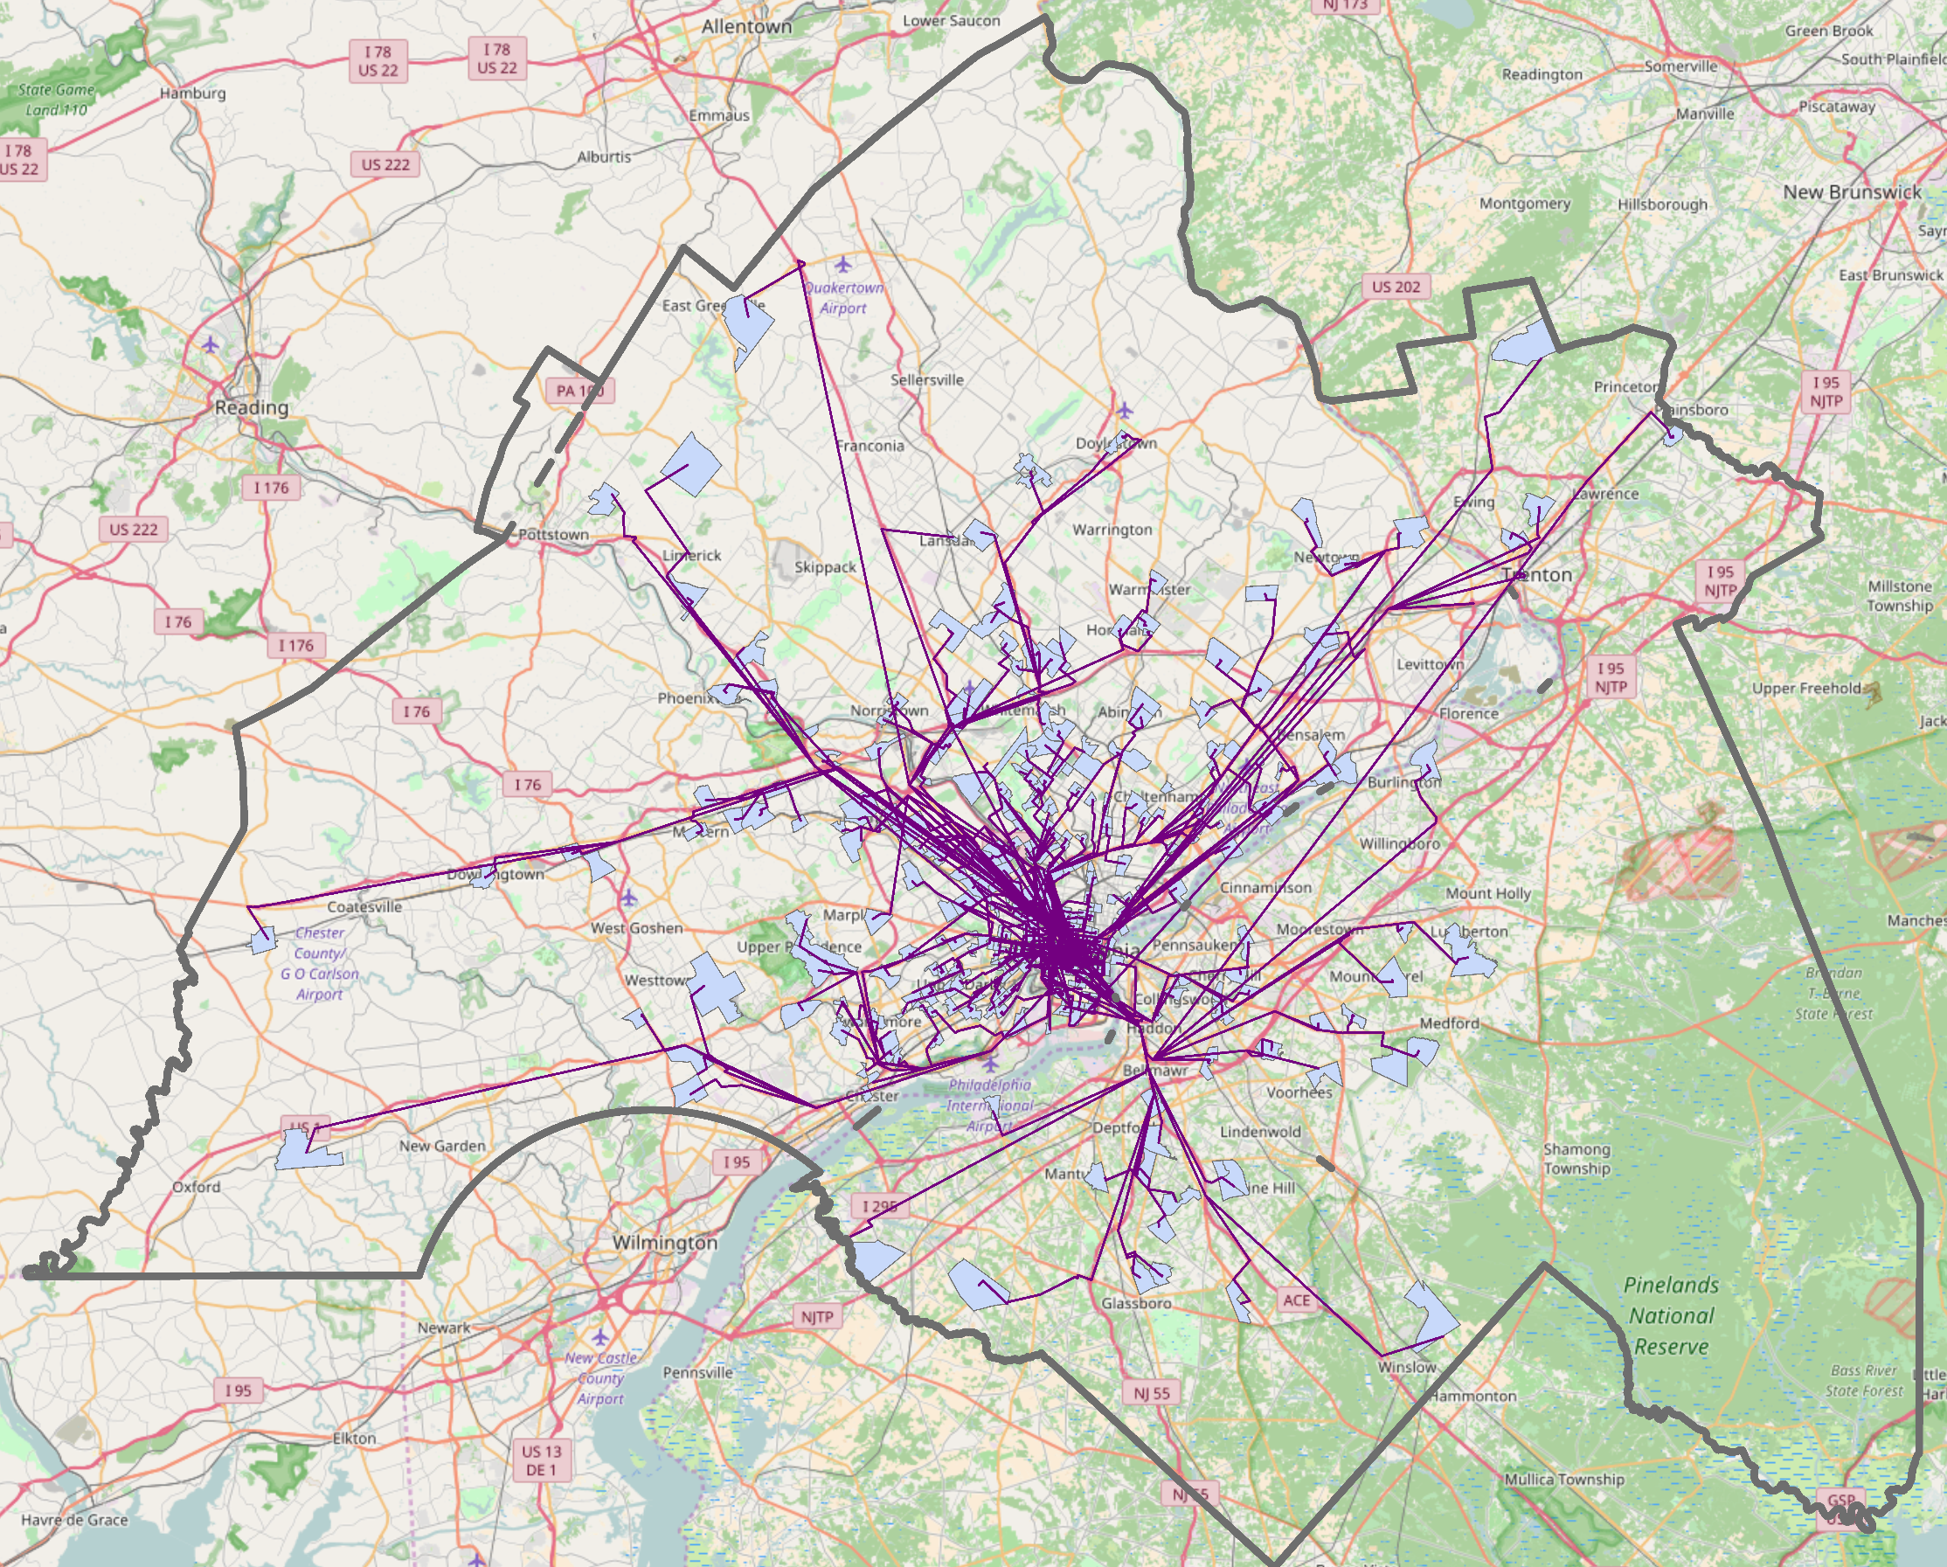
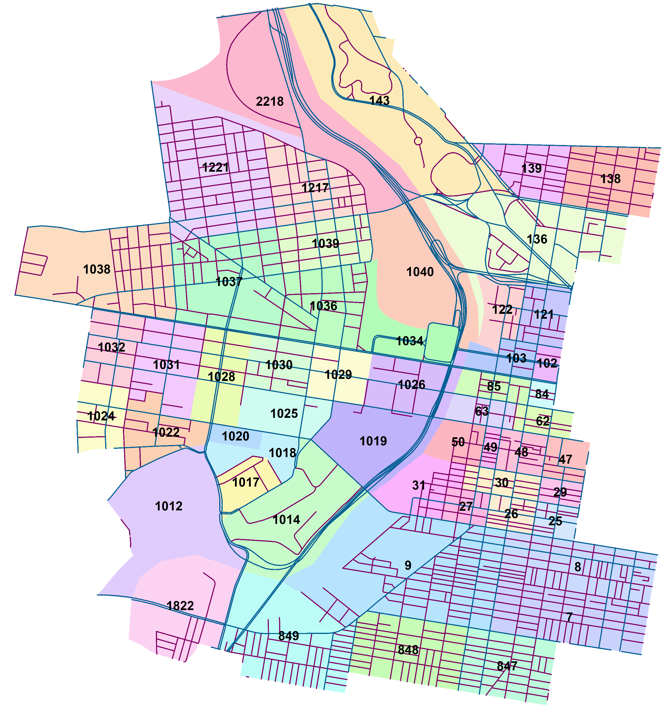
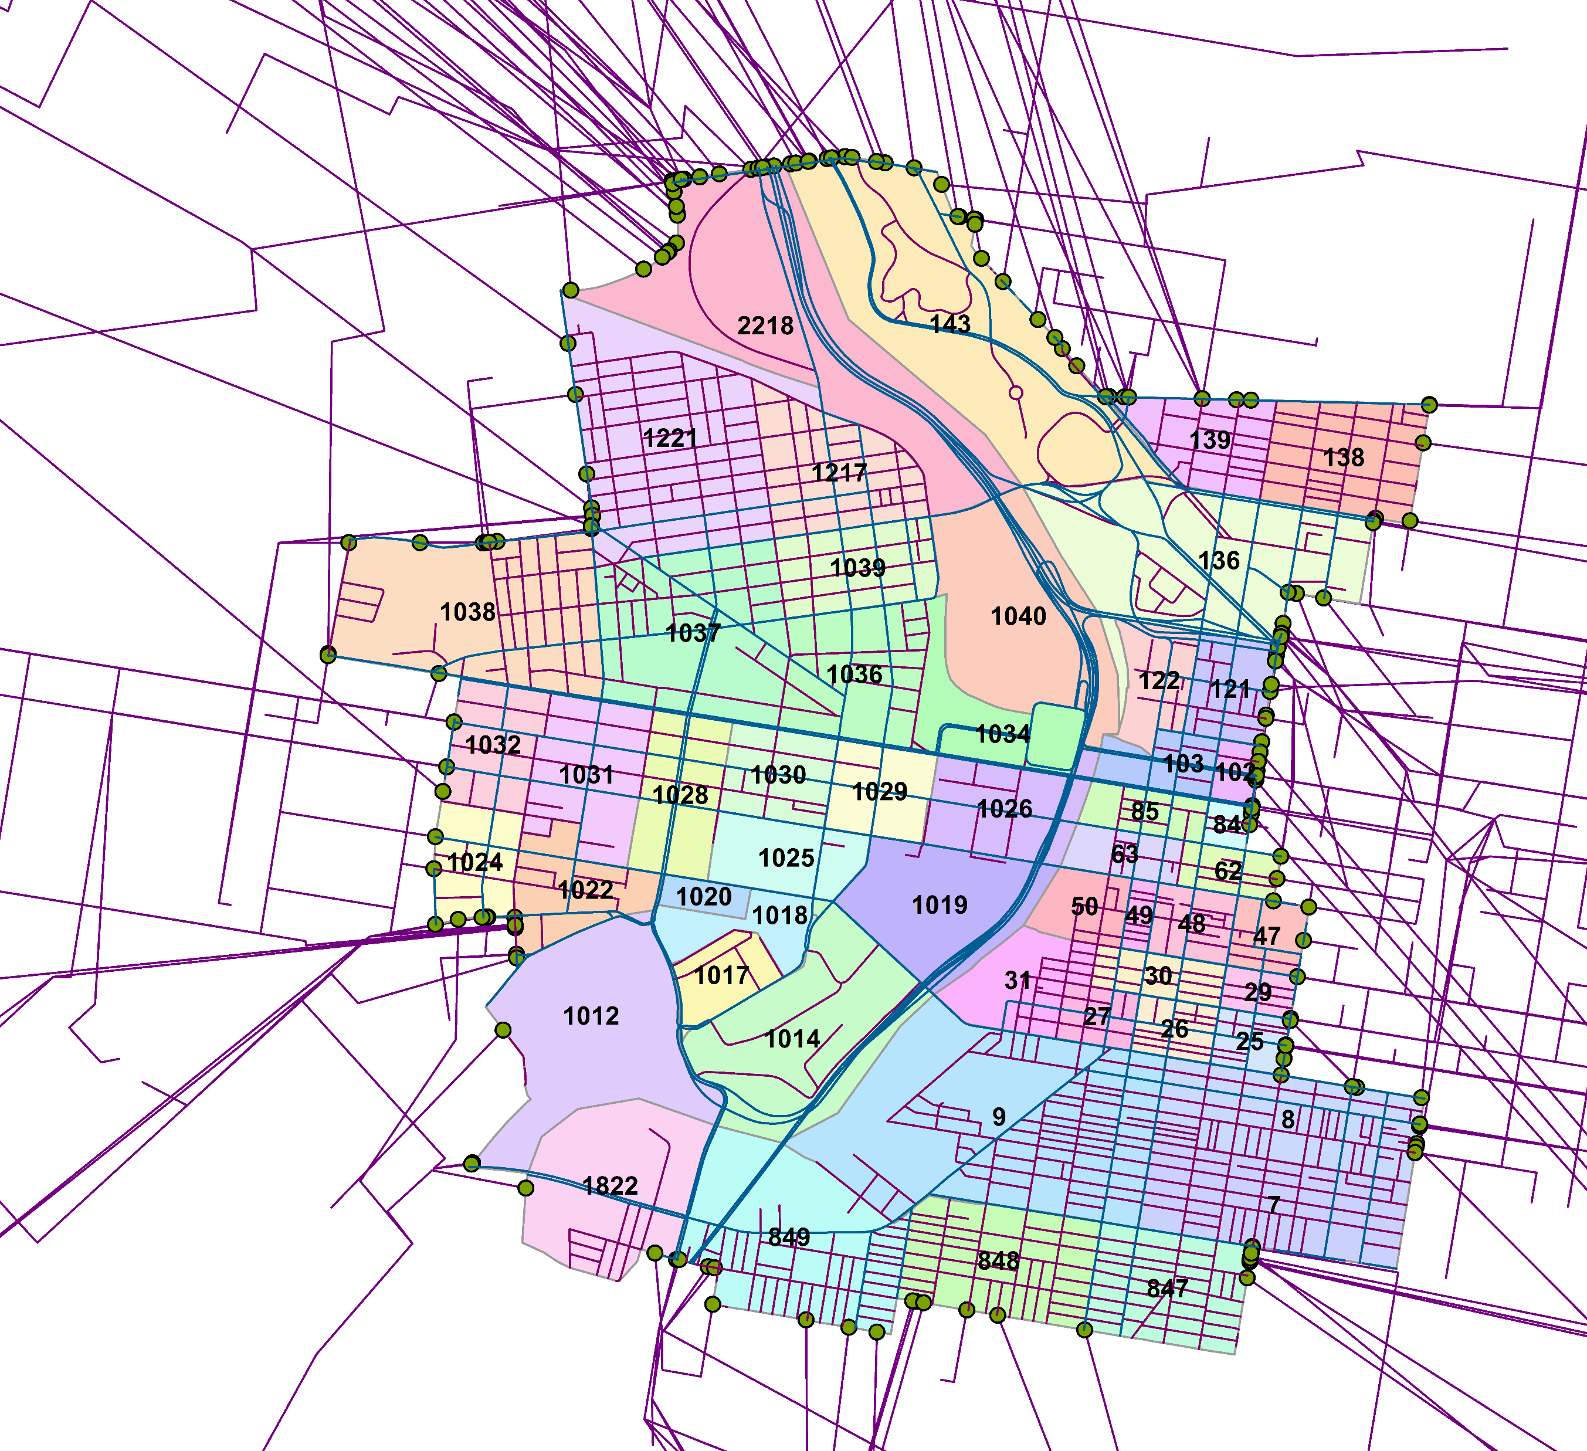
Mapping TAZs- From DVRPC to the AOI to the edges
TAZ = Traffic Analysis Zones
Notes:
file:///C:\Users\Biko\Dropbox\PhD\Research\Models\SUMO\DVRPC\TAZ\Traffic_Count_TAZ_SpatialJoin_1.xlsx

Slide 80
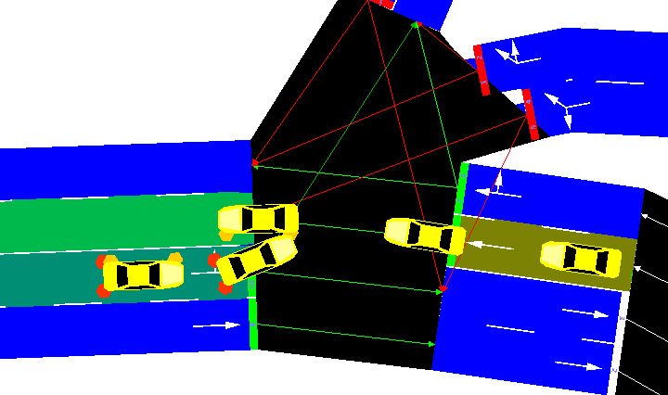
Accidents Happen…
SUMO Simulation Accident Options
--ignore-accidents <BOOL> | Do not check whether accidents occur; default: false
--collision.action <STRING> | How to deal with collisions: [none,warn,teleport,remove]; default: teleport
--collision.stoptime <TIME> | Let vehicle stop for TIME before performing collision.action (except for action 'none')
--collision.check-junctions <BOOL> | Enables collisions checks on junctions; default: false

Slide 81
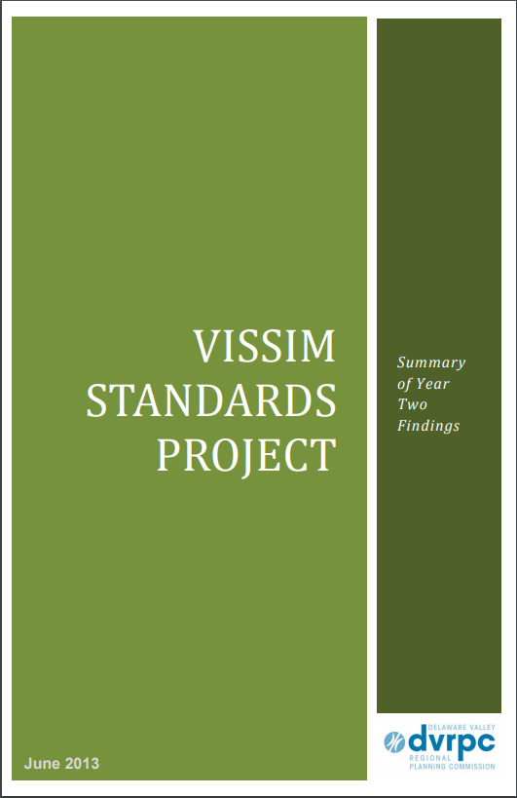
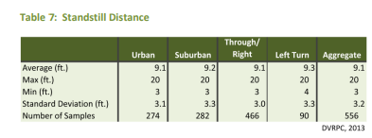
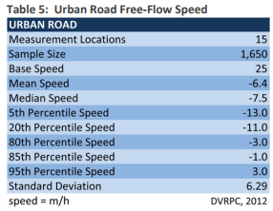



Slide 82
Dynamic Network Analysis & Real-time Traffic Management for Philadelphia Metropolitan Area
Final Report 2016 - Carnegie Mellon & PennDOT - http://weima171.com/docs/WO004_final.pdf
Executive Summary
This project developed a general regional network model to estimate/predict time-varying traffic evolution on all highways and major arterials in Philadelphia Metropolitan Region. A case study was conducted for assessing the dynamic traffic impact of road closures on freeways and/or major arterials in the Philadelphia Region; and propose real-time traffic detour plans as a way of using travel demand management (TDM) strategies to mitigate overall impact caused by closures
…The historical O-D demand data was also obtained from DVRPC in the format of VISUM. The O-D matrix is represented by a 3399 × 3399 matrix and in float precision. DVRPC also provided a main O-D pairs profile, which contains 10,000 main O-Ds. O-D connectors are also contained in the TIM2.1 model, the total number of O-D connectors is 11,553,201.
2.1 Route choice model
Route choice model is a crucial part to real-time traffic simulation. Under static network setting, the route choice of travelers is usually determined by a user equilibrium (UE) flow pattern (Sheffi 1985). In dynamic context, there are generally two types of UE in the literature. One is the so-called Boston User Equilibrium (BUE) (Friesz et al. 1993), which is an adaption of the static Wardroppian UE. It assumes a traveler chooses the shortest route only based on the prevailing traffic condition at the time of his choice decision (Kuwahara & Akamatsu 2001). The other UE type is the so-called Predictive User Equilibrium (PUE). Under this behavioral assumption, travelers choose the shortest route based on “anticipated" travel times, or travel times that they actually experienced from previous days. The result is a UE in which the actual travel times/costs for travelers from any O-D pair are minimal and identical (Friesz et al. 1993), regardless the routes they take. In reality, traveler’s route choice behavior is likely to be more complicated and unpredicted than BUE and PUE. For example, travelers may not consider all the possible routes but have several pre-trip routes in mind prior to their departure, which are selected from their day-to-day traveling experiences. Moreover, these pre-selected routes may not be user-optimal ones. In view of this, a hybrid traffic assignment model was purposed to model both equilibrium and disequilibrium traffic conditions (Qian & Zhang 2013). We adopt the hybrid model in this project with the diversion ratio indicating how reactive travelers are in choosing routes.
2.2 Flow evolution model
The flow evolution models describe the dynamic relationship between vehicle density, speed and volume for one road segment. Three models are most adopted by various mesoscopic traffic simulation tools: Point Queue (PQ) (Jin 2015), Spatial Queue (SQ) (Balmer et al. 2004; Breuer 2001) and Cell Transmission Model (CTM) (Daganzo 1995; Daganzo 1999). Though mathematically and practically simple, PQ and SQ are considered to underestimate the network congestion during the simulation (Zhang et al. 2013). CTM as a finite element approximation to the partial differential equation of fluid evolution is proved to best simulate the flow propagation on road segments. A vital issue exists for all dynamic flow evolution models, which is the unrealistic “gridlock” caused by improper routing behavior and misbehave of flow evolution models (Mahmassani et al. 2013). -- In this project, we adopt CTM to simulate the flow propagation on links, and the unrealistic gridlock condition is eliminated by calibrating behavior model parameters and network dynamic features.

Slide 83

VISUM – Functionality
PTV Visum Functions
Network modelling
Demand calculations
PrT assignment procedures
PuT assignment procedures and operations
Traffic engineering
Create analyses and reports
Interfaces
Used by Dr. Pradhan’s PhD Student
“Dongle” is active, but no support is available
Educational / Researcher’s License
$1,950 – one-time purchase
2 year – technical support
Includes Visum, Visim, Viswalk
Notes:
Contacted DR. RYERSON (@UPENN) to see if she can use VISUM to generate the TAZ to TAZ O/D Matrix.
-No response yet

Slide 84
Theatrical Capacity of Roadways
Click for new presentation

Slide 86
Carrier Goals
Continue to work towards and research topics related to increasing the current and future livability of cities
Stay involved and connected to Complex Sociotechnical Systems
Work in some capacity with City infrastructure systems or City Planning
Exploring coordination between strongly interdependent systems, departments, and agencies
Can incentives be created in which agencies’ actions promote increased citywide LSR and not just focused on asset or specific systems.
Work directly with transportation infrastructure assets
Performance based risk asset management
Or hands on design-build work
Continue working in Education
At any level
Obtain my P.E.

Slide 87
Appendix Python_Code

